Slide 1
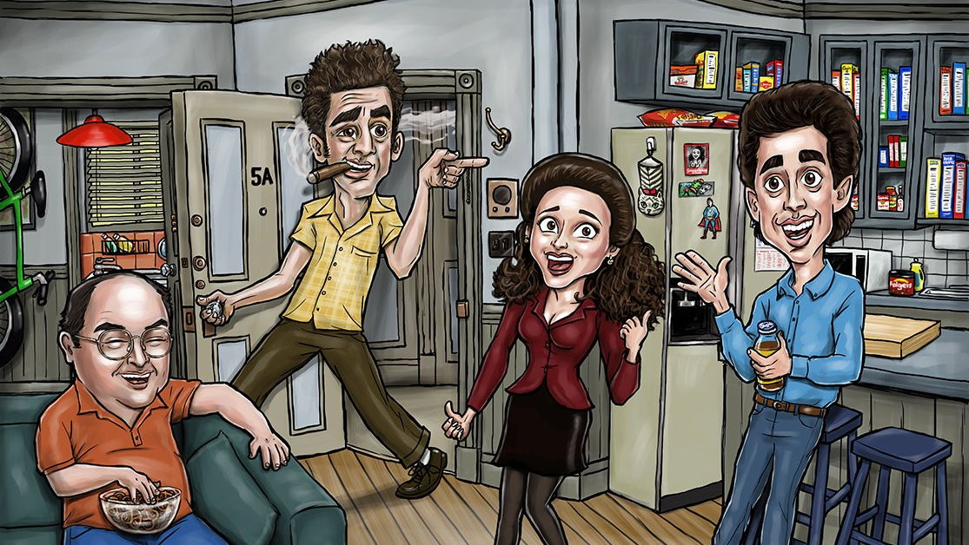
Seinfeld

Slide 2
Motivations
“Best sitcom ever made”

Slide 3
Motivations
“Best sitcom ever made”
Main cast are anti-heroes

Slide 4
Motivations
“Best sitcom ever made”
Main cast are anti-heroes
George Costanza (aka ”Can’t Stand-ya”)

Slide 5
Motivations
“Best sitcom ever made”
Main cast are anti-heroes
George Costanza (aka ”Can’t Stand-ya”)
“Short, Stocky, slow-witted, bald man”
“weak, spineless, man of temptations”
“lord of the idiots”
Neurotic, self-loathing, dishonest, insecure, anxious, over-confident

Slide 6
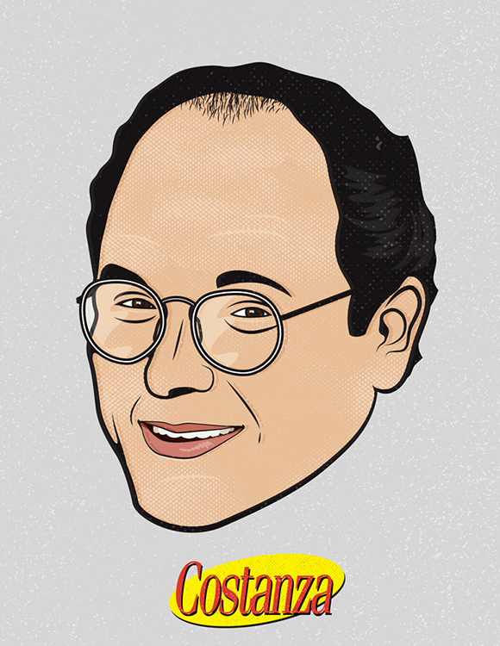
Psychoanalysis of George Costanza

Slide 7
Agenda Psychoanalyze George ”Can’t Stand ya”
Data and Processes
Topic Modeling & Sentiment analysis
EDA

Slide 8
Data & Processes
Data
Seinfeld Transcripts https://www.kaggle.com/thec03u5/seinfeld-chronicles
9 seasons (1989-1998)
173 episodes
Document level – character lines per episode
Processes
Topic Modeling (SVD, NMF, LDA)
Kmeans Clustering
Sentiment / Emotions
Textblob
Vader
Lexicon of emotions (National Research Council of Canada)

Slide 9
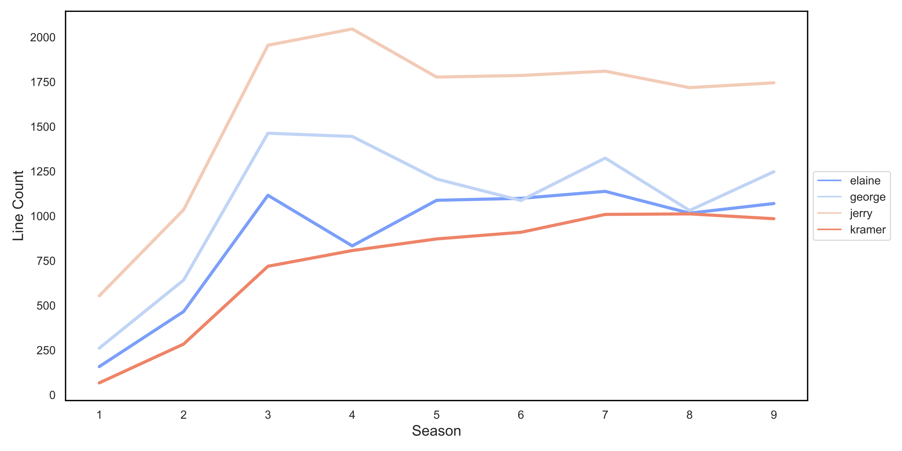




EDA
Character Line Counts by Season

Slide 10
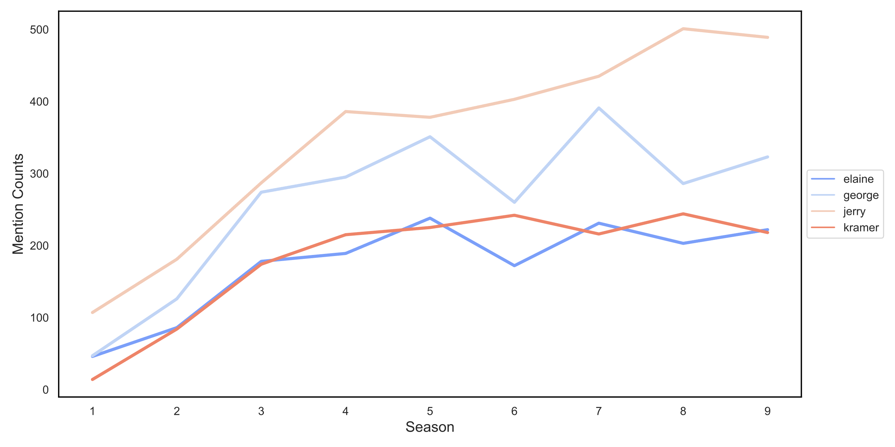
EDA
Character Mentions by Season
Director Replacement

Slide 11
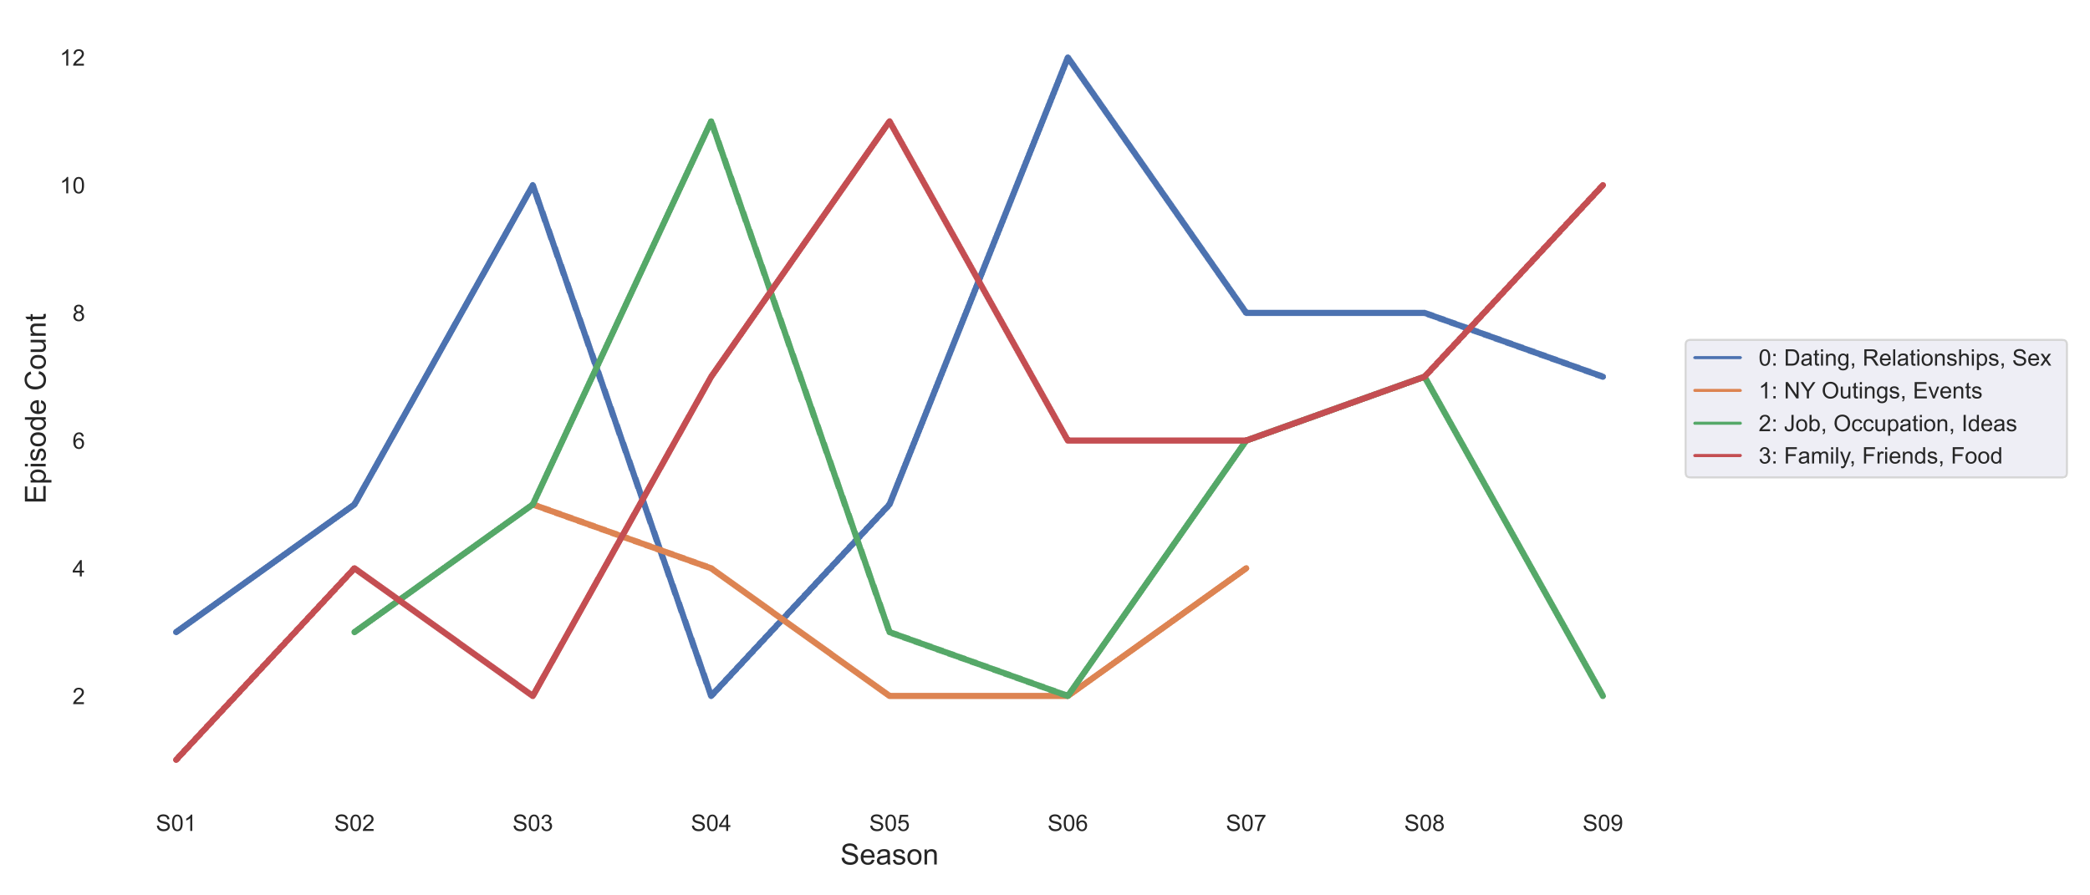
Topic Modeling
Constanza
Process:
Lemmatization
NMF Model (tried others)
Min_df=0.03
Max_df=0.85
Topic 0:
Dating, Relationships, Sex
Topic 1:
NY Outings, Events
Topic 2:
Jobs, Occupations, Ideas
Topic 3:
Family, Friends, Food

Slide 12
Topic Modeling
Constanza
Stable job as writer
Mostly Dating, not relationships
Moves in with parents
Process:
Lemmatization
NMF Model (tried others)
Min_df=0.03
Max_df=0.85
Topic 0:
Dating, Relationships, Sex
Topic 1:
NY Outings, Events
Topic 2:
Jobs, Occupations, Ideas
Topic 3:
Family, Friends, Food
Outings coincide with other topics

Slide 13
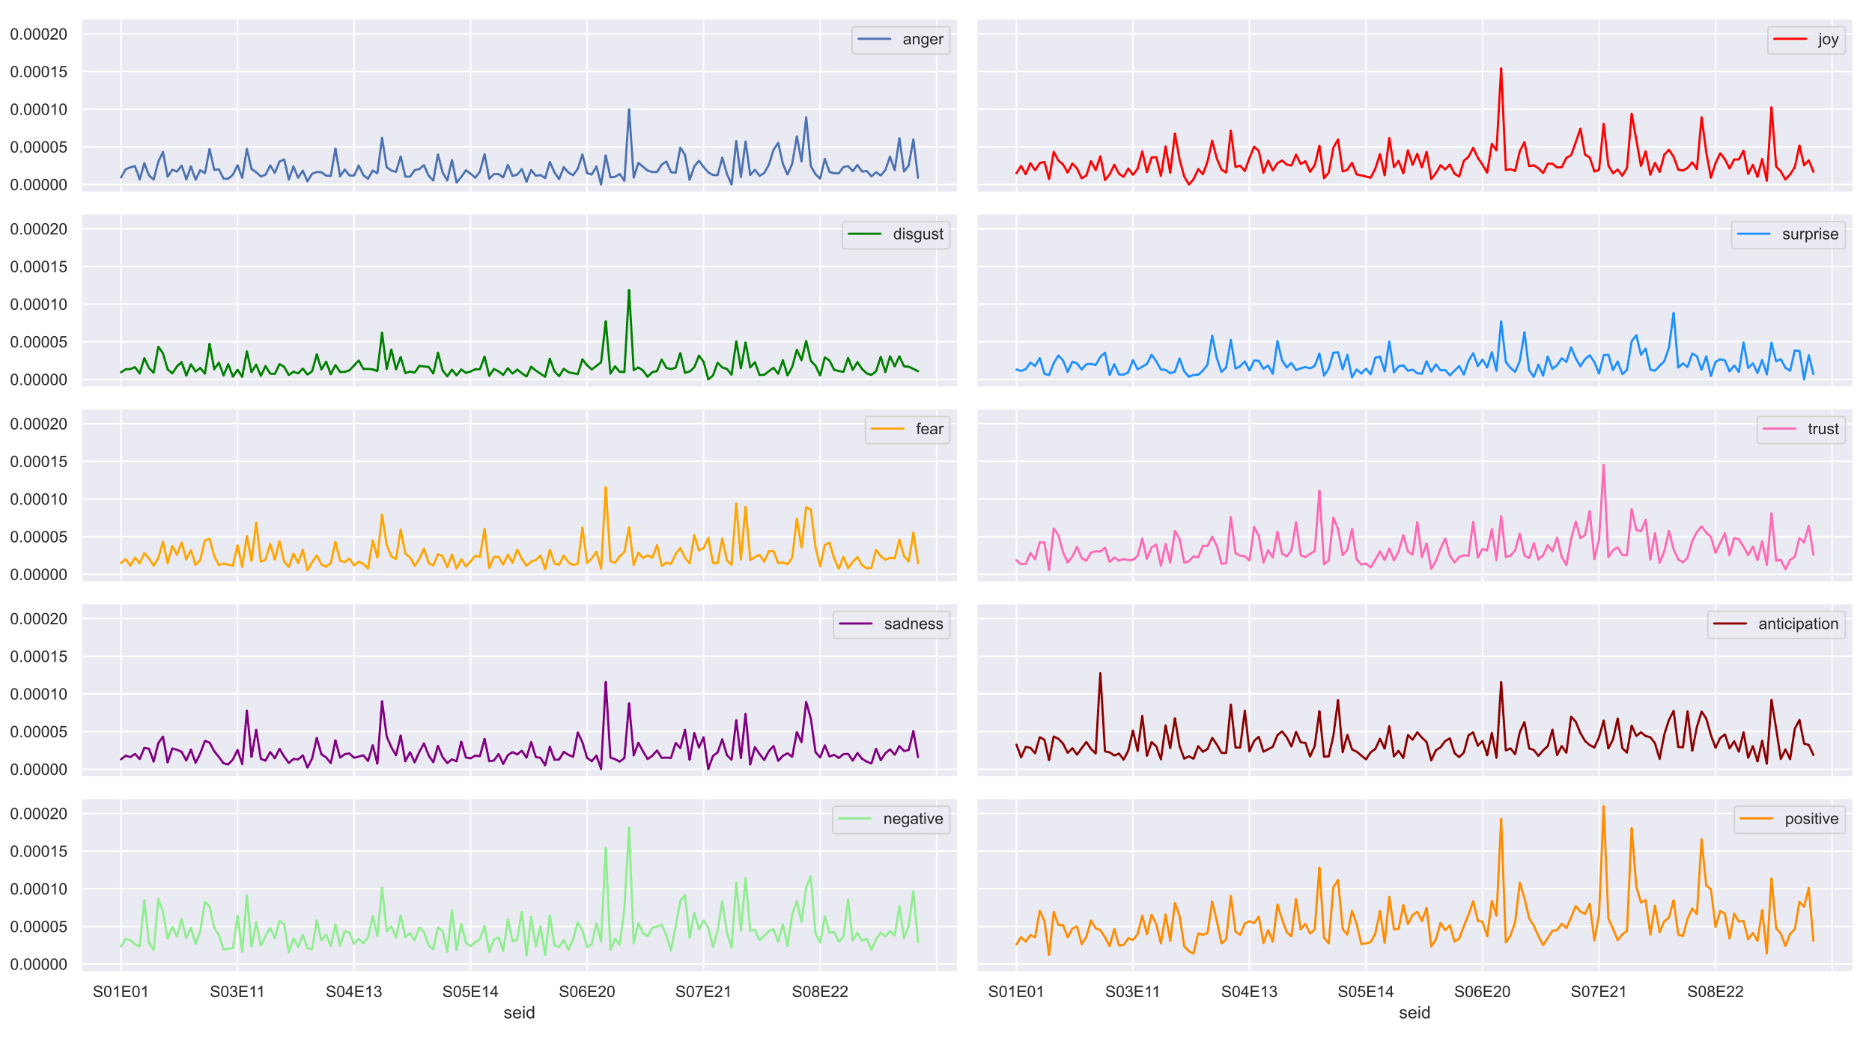
Emotional Analysis
Costanza
Anger
Joy
Disgust
Surprise
Fear
Trust
Sadness
Anticipation
Negative Sentiment
Positive
Sentiment

Slide 14
Emotional Analysis
Costanza
Negative
Positive
Anger
Joy
Disgust
Surprise
Fear
Trust
Sadness
Anticipation
Negative Sentiment
Positive
Sentiment

Slide 15
Emotional Analysis
Costanza
Negative
Positive
George is praised by his boss
Anger
Joy
Disgust
Surprise
Fear
Trust
Sadness
Anticipation
Negative Sentiment
Positive
Sentiment

Slide 16
Emotional Analysis
Costanza
George gets engaged (has regrets)
George is praised by his boss
Negative
Positive
Anger
Joy
Disgust
Surprise
Fear
Trust
Sadness
Anticipation
Negative Sentiment
Positive
Sentiment

Slide 17
Emotional Analysis
Costanza
Negative
Positive
Anger
Joy
Disgust
Surprise
Fear
Trust
Sadness
Anticipation
Negative Sentiment
Positive
Sentiment

Slide 18
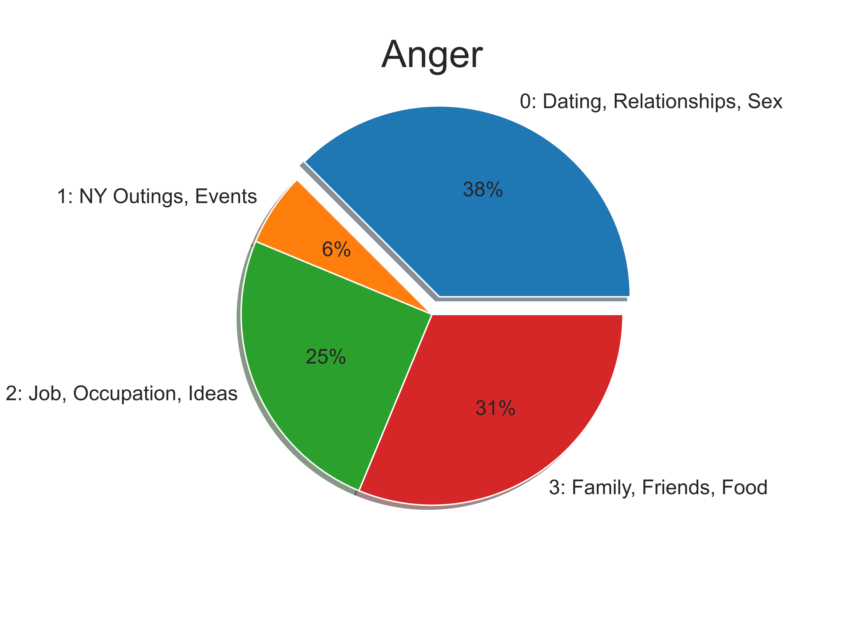
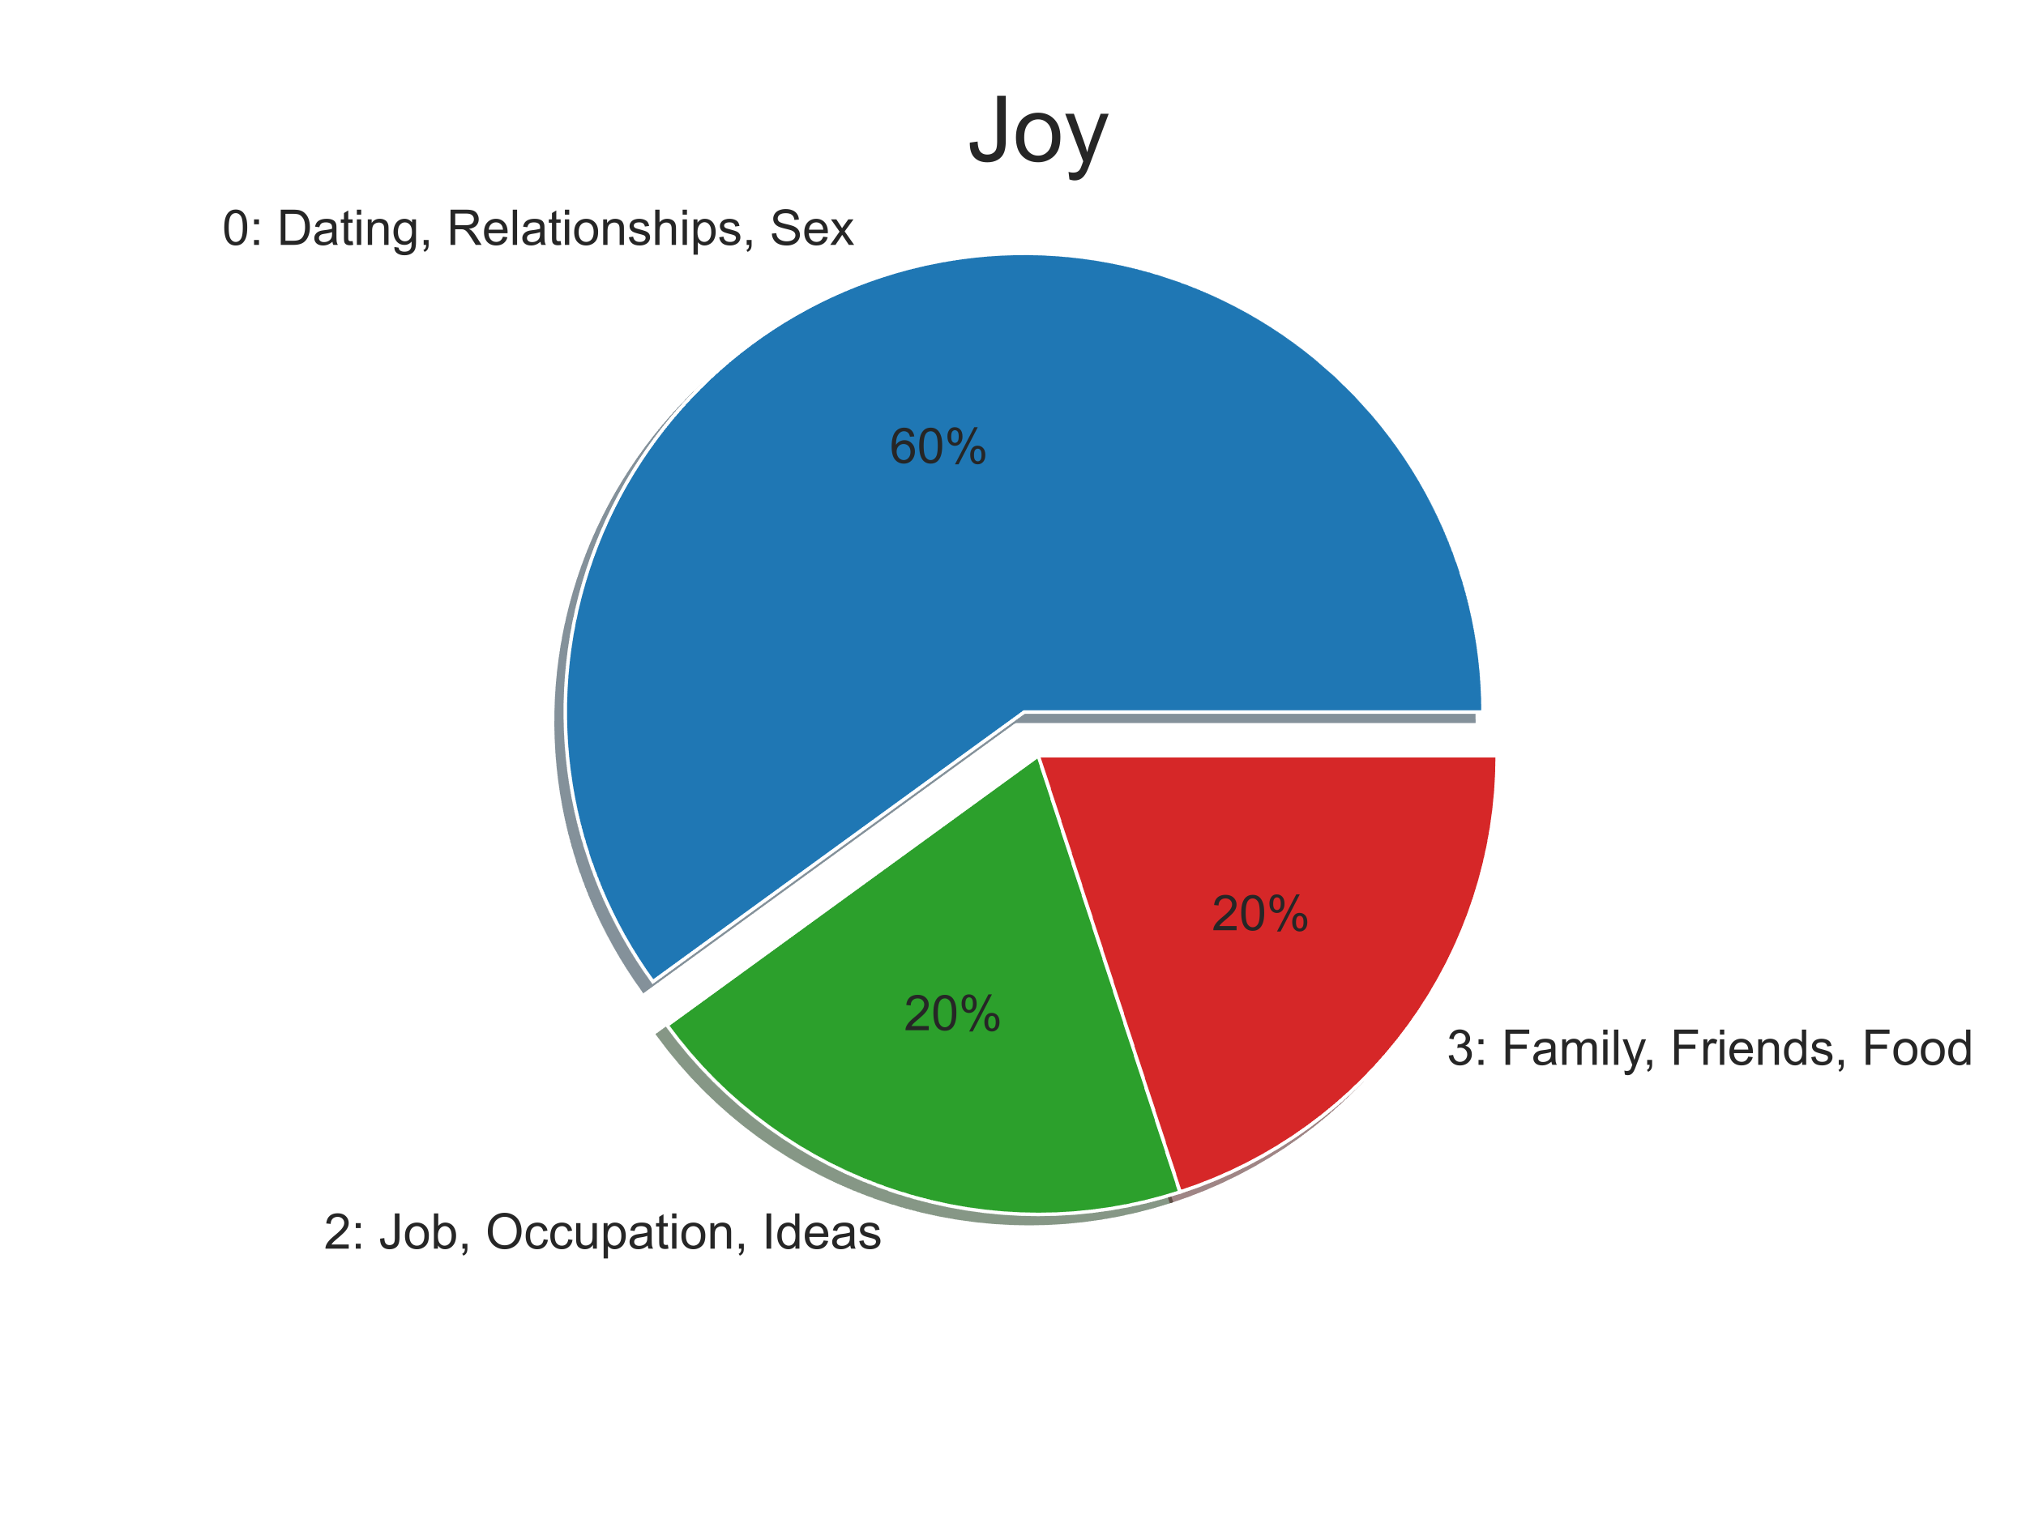
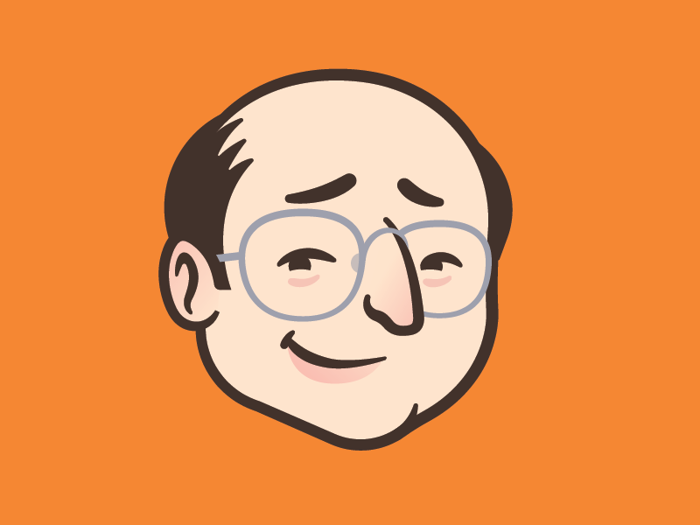
Emotions by Topics Costanza
“This woman hates me so much, I’m starting to like her”

Slide 19
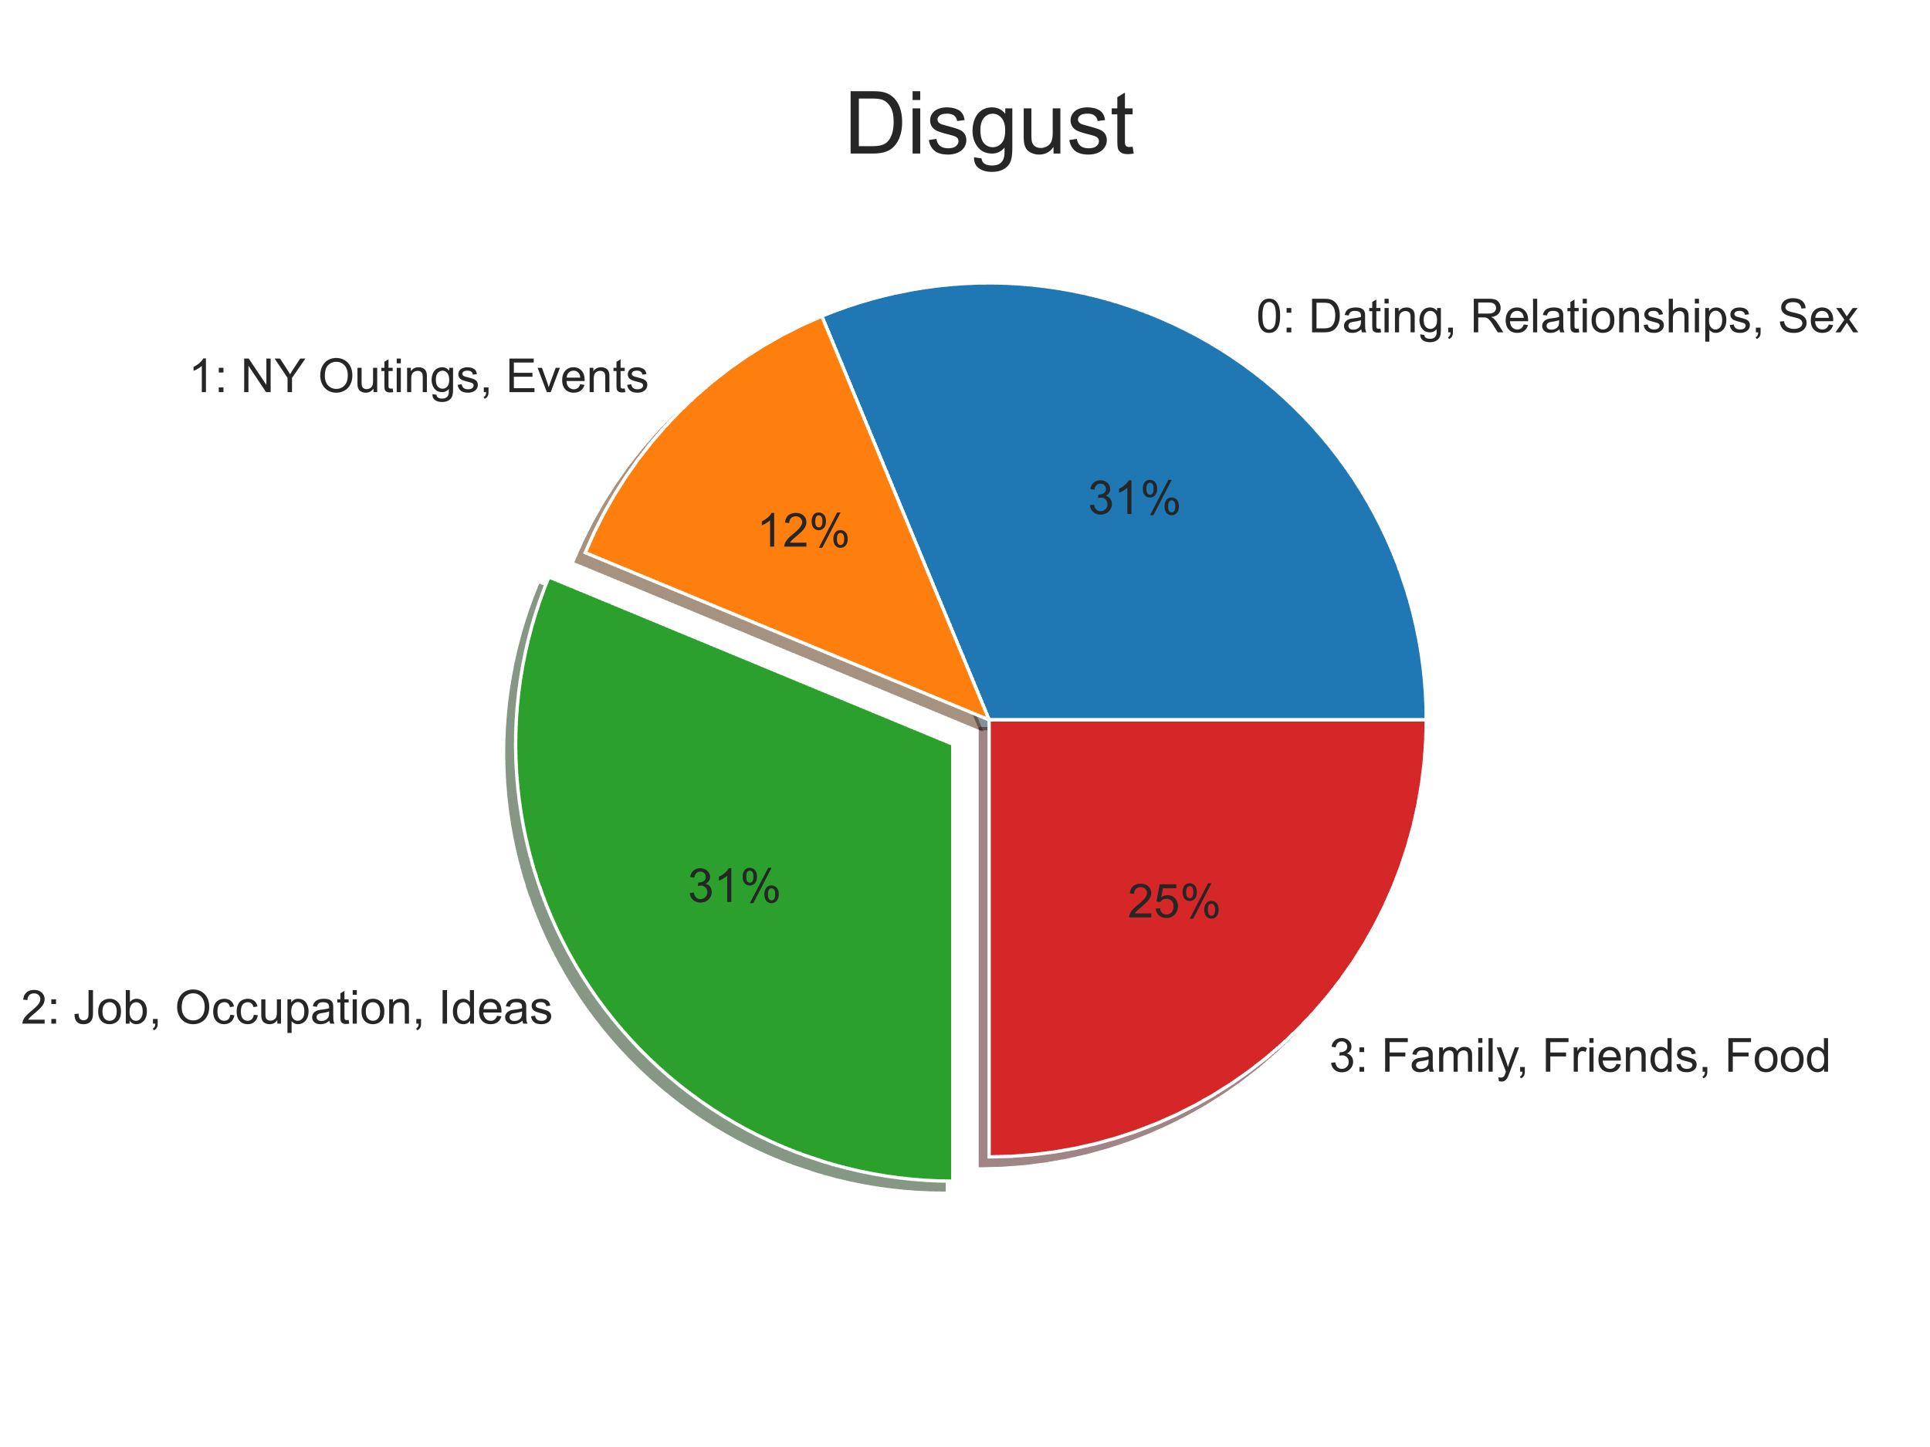
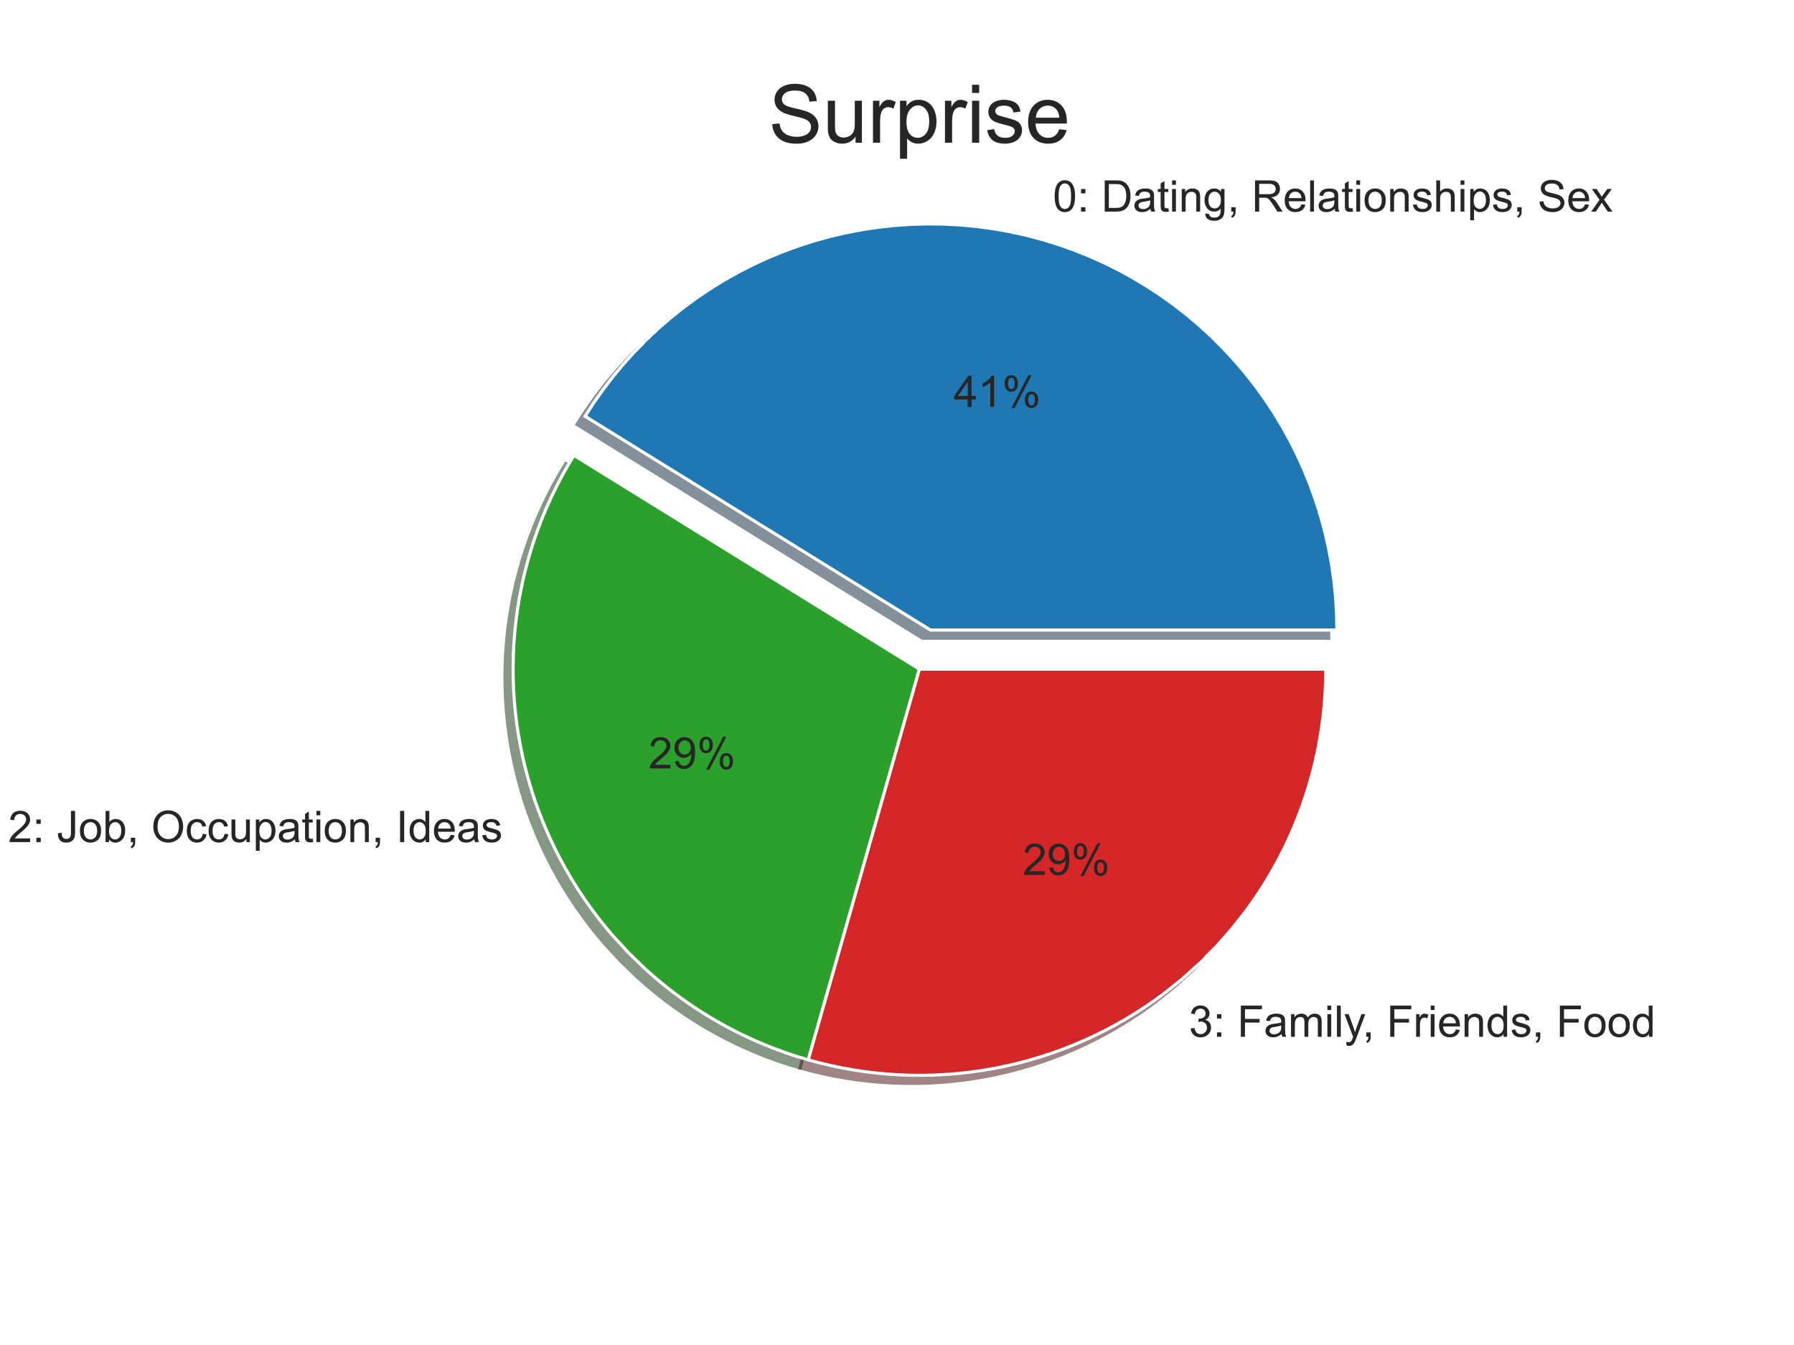
Emotions by Topics Costanza
“You know I always wanted to pretend I was an architect”

Slide 20
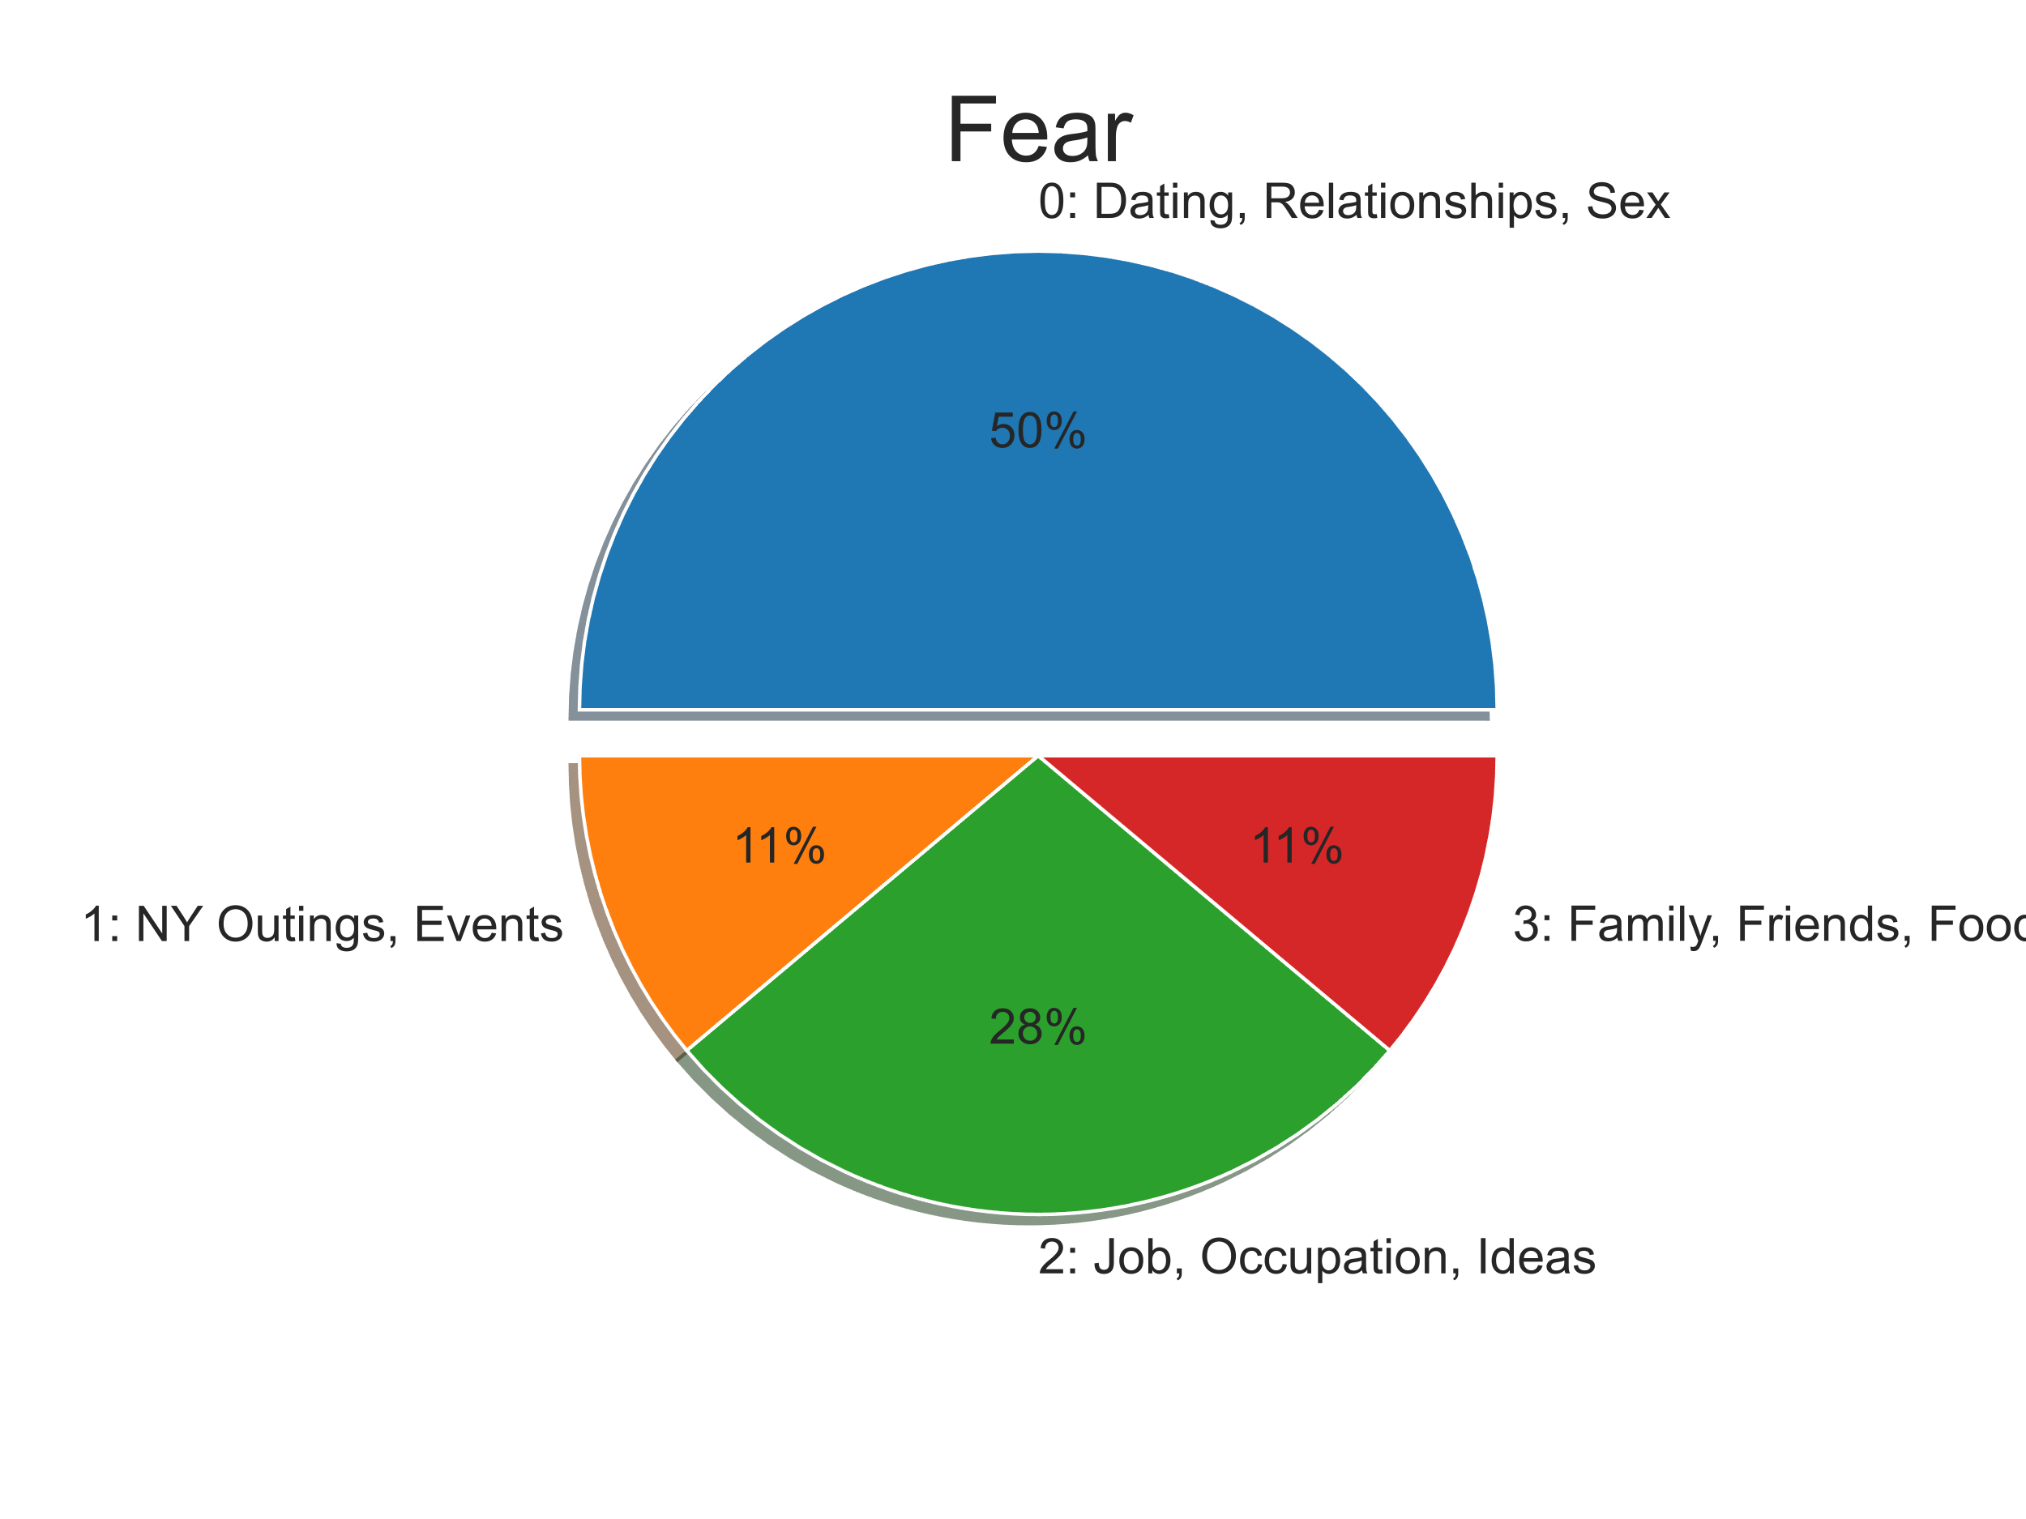
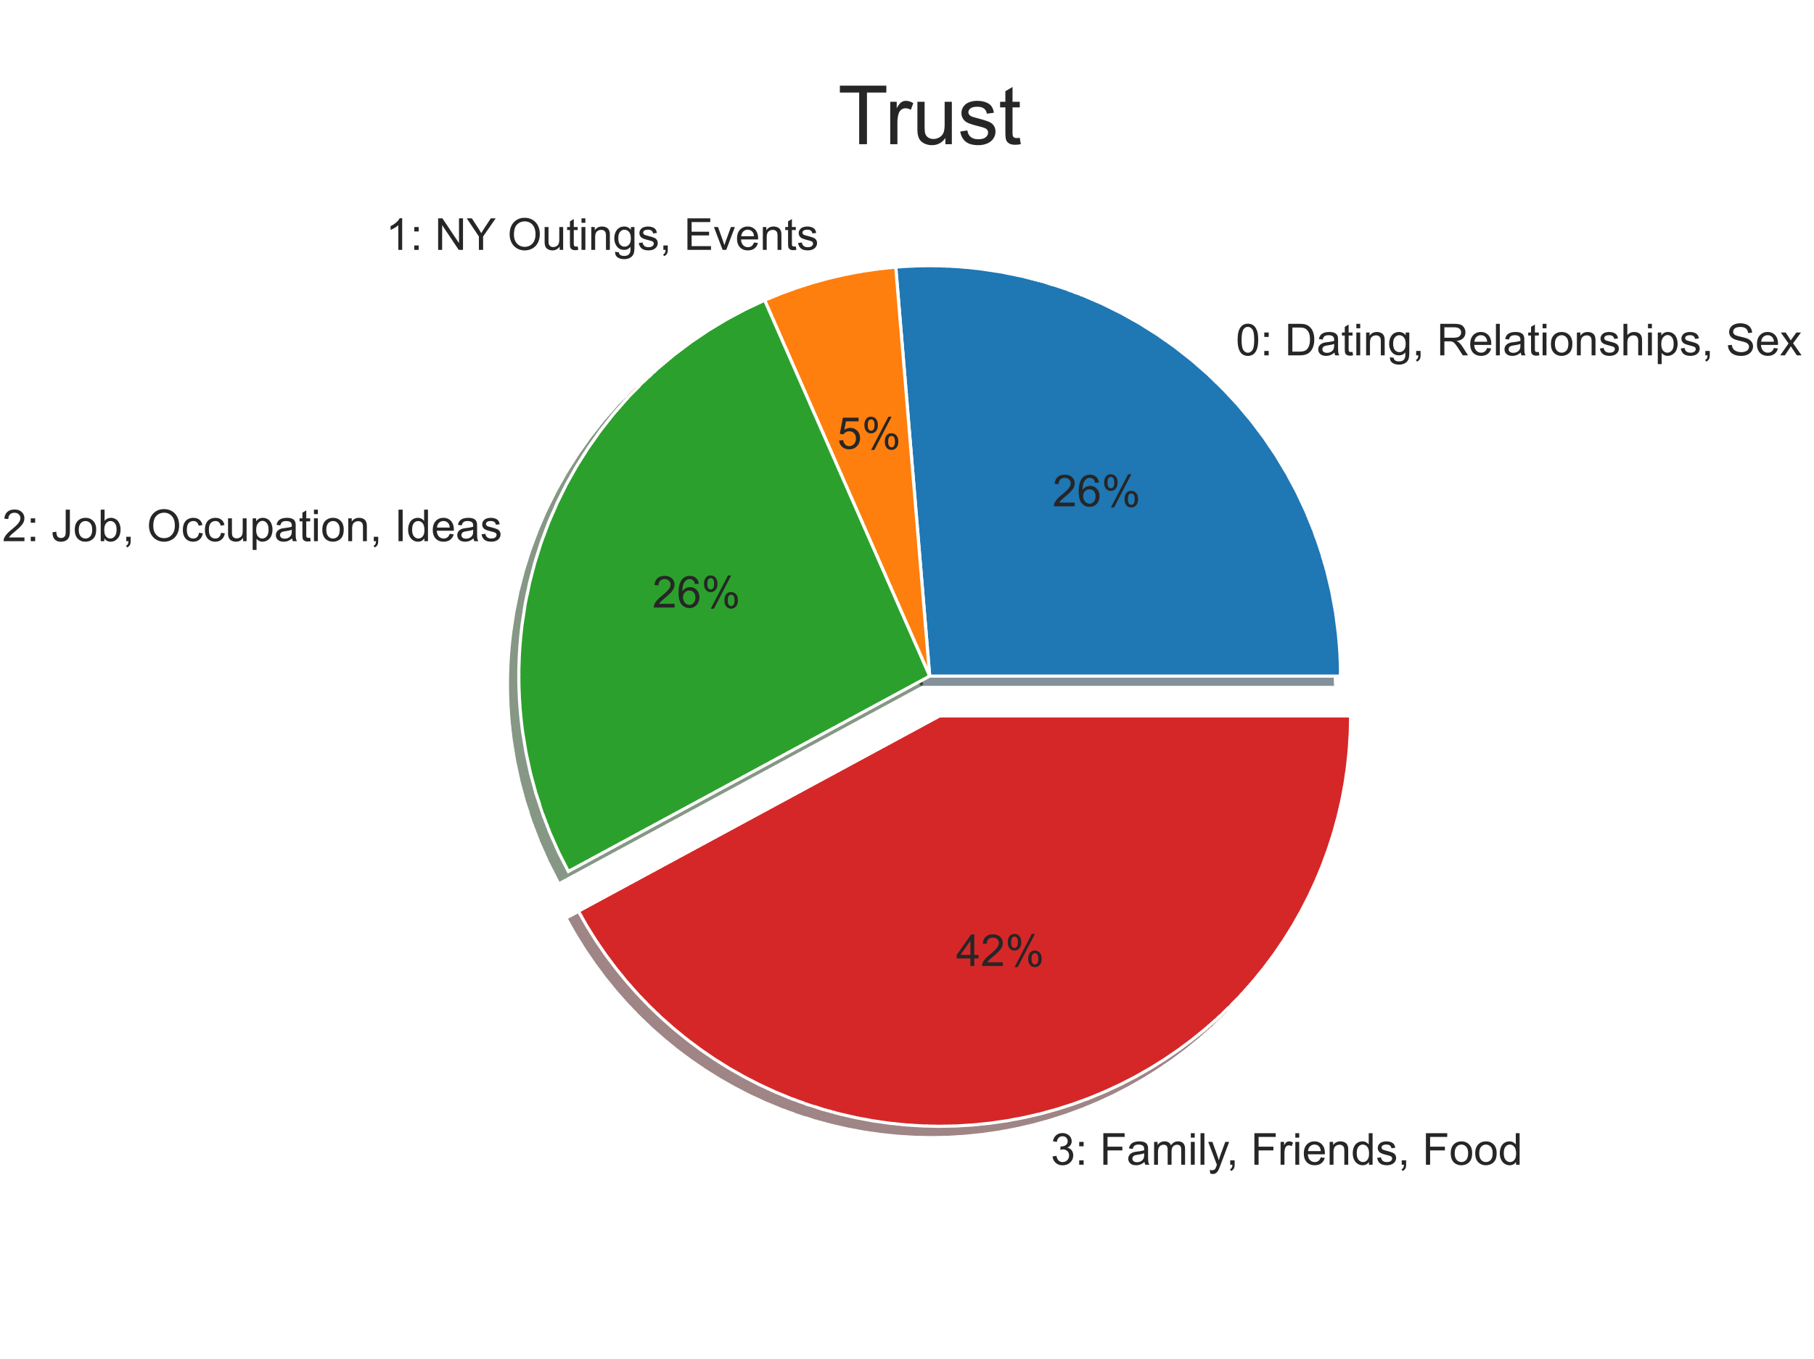
Emotions by Topics Costanza
“I don’t trust men in capes”

Slide 21
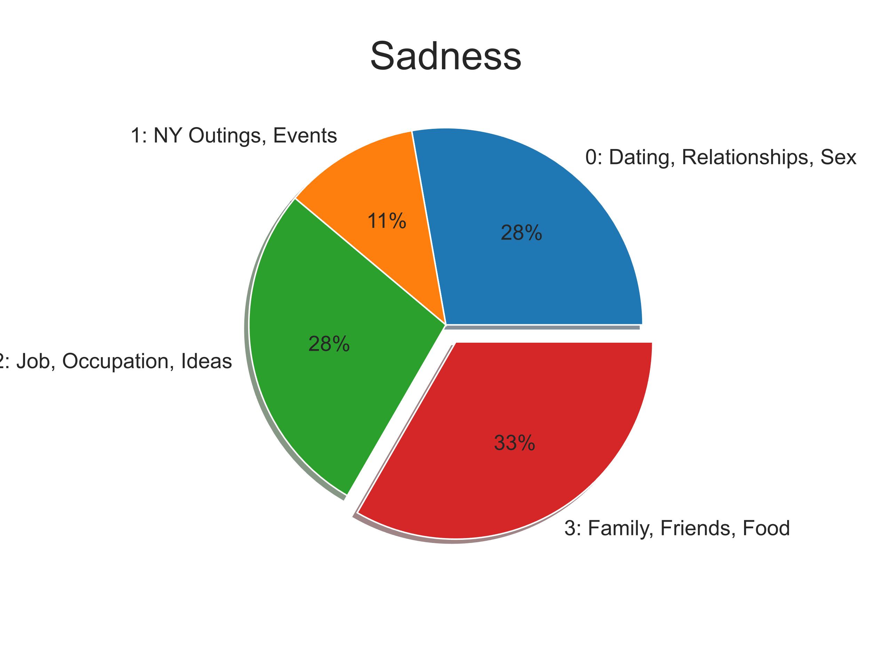
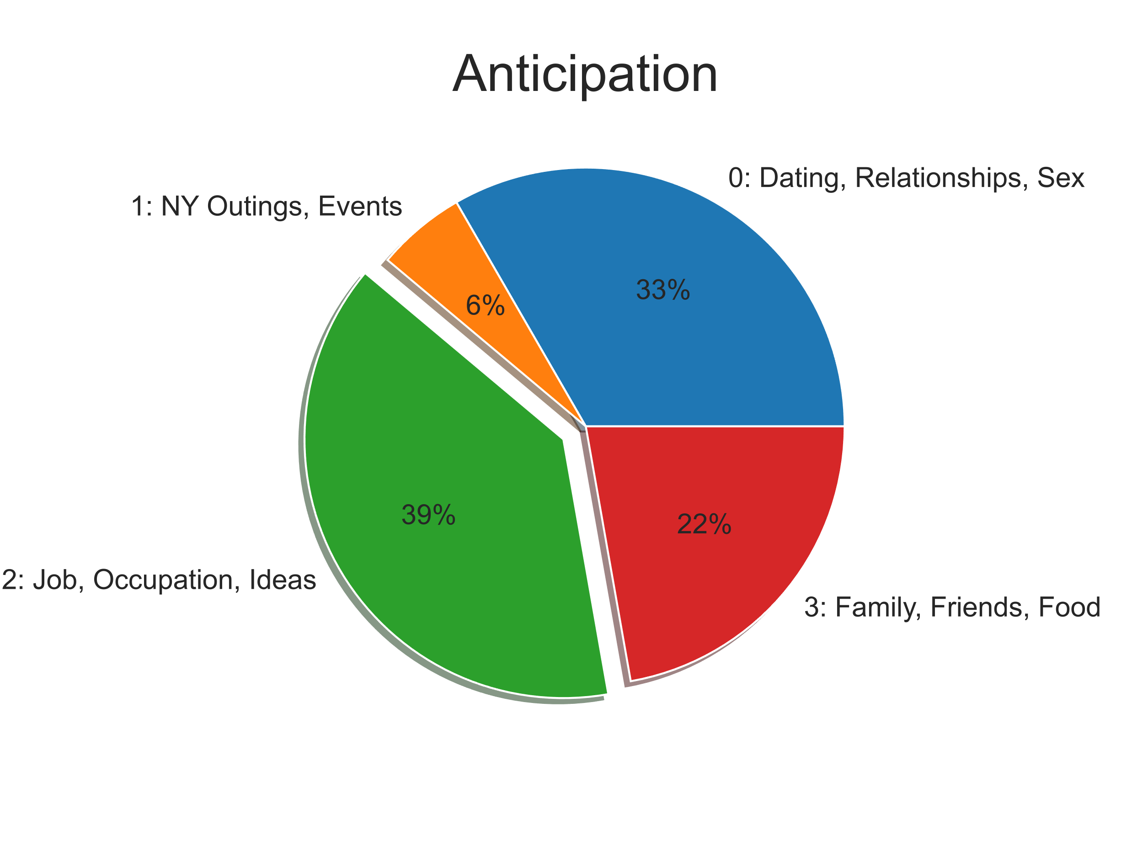
Emotions by Topics Costanza
“I’m disturbed. I’m depressed. I’m inadequate. I got it all!”

Slide 22
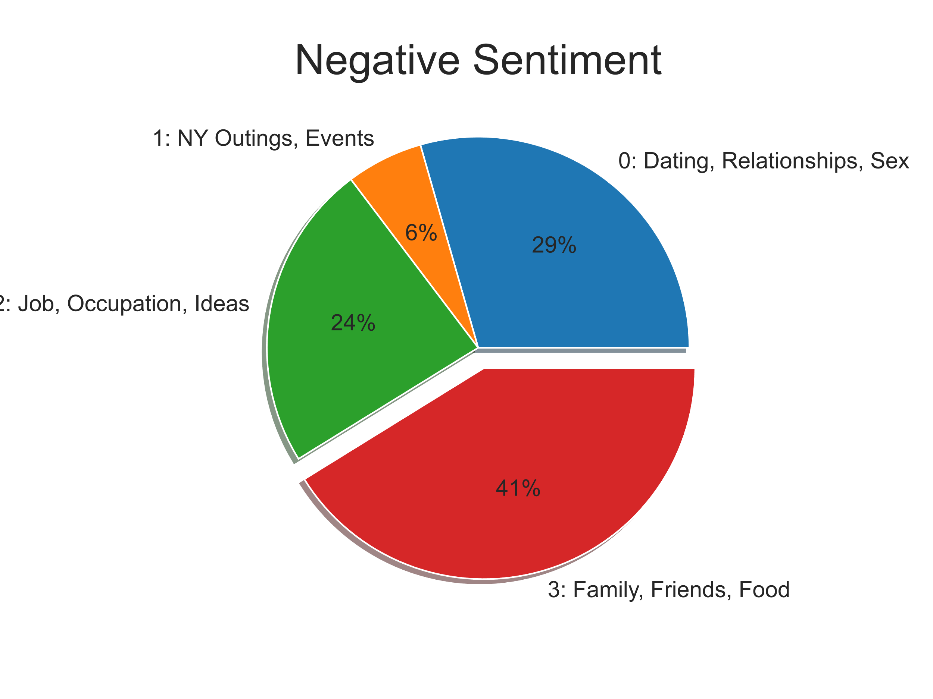
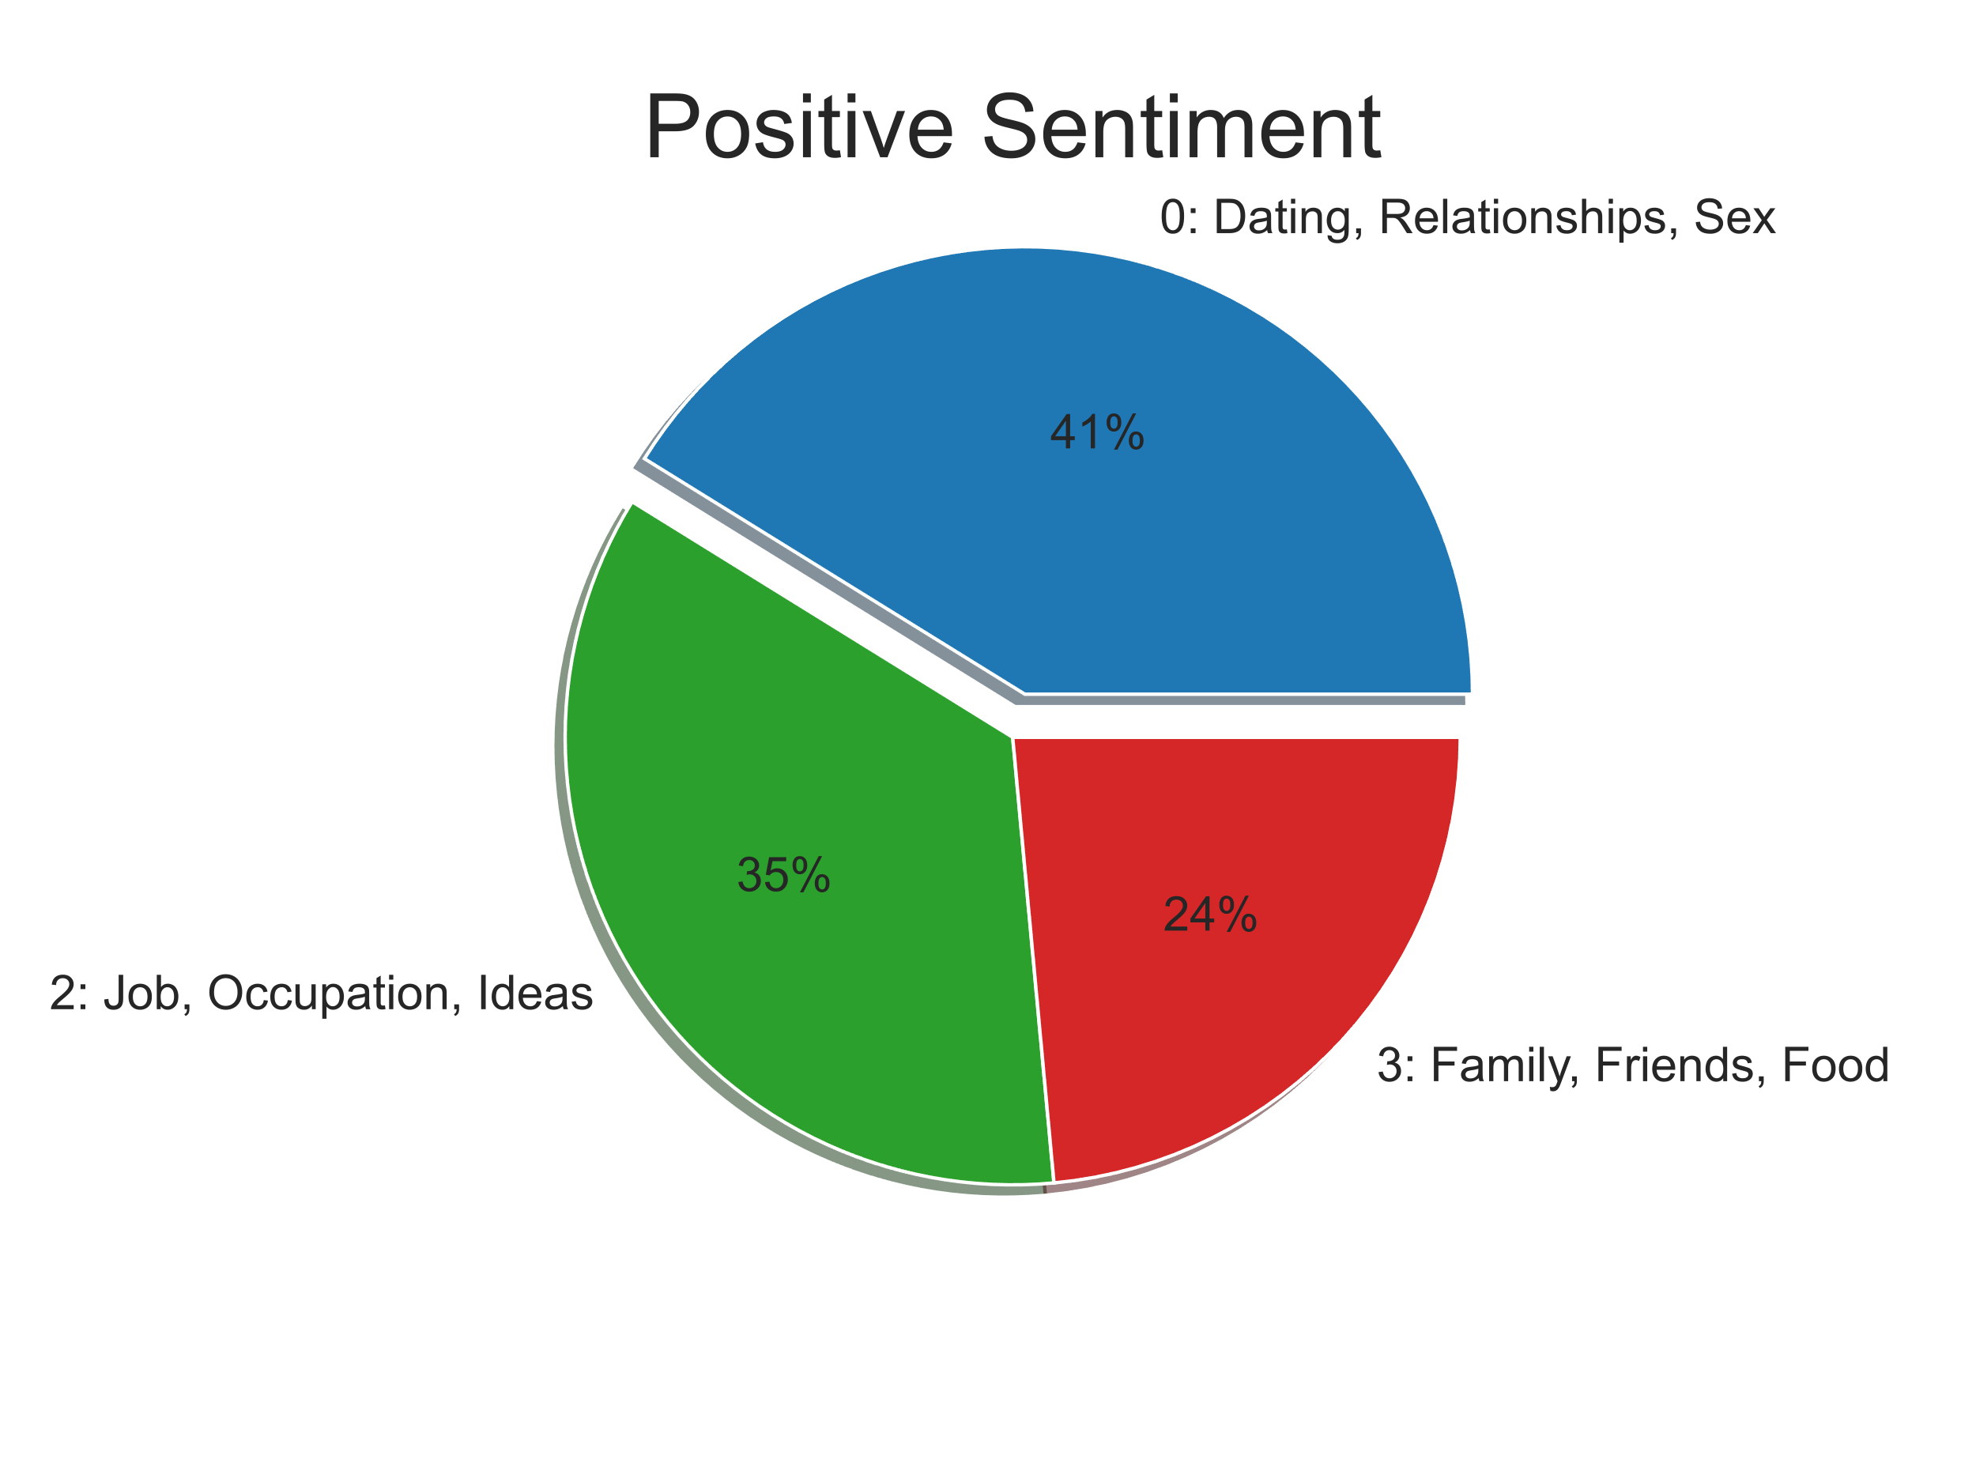
Sentiment by Topics
Costanza
“Divorce is always hard. Especially on the kids. 'Course I am the result of my parents having stayed together so ya never know”

Slide 23
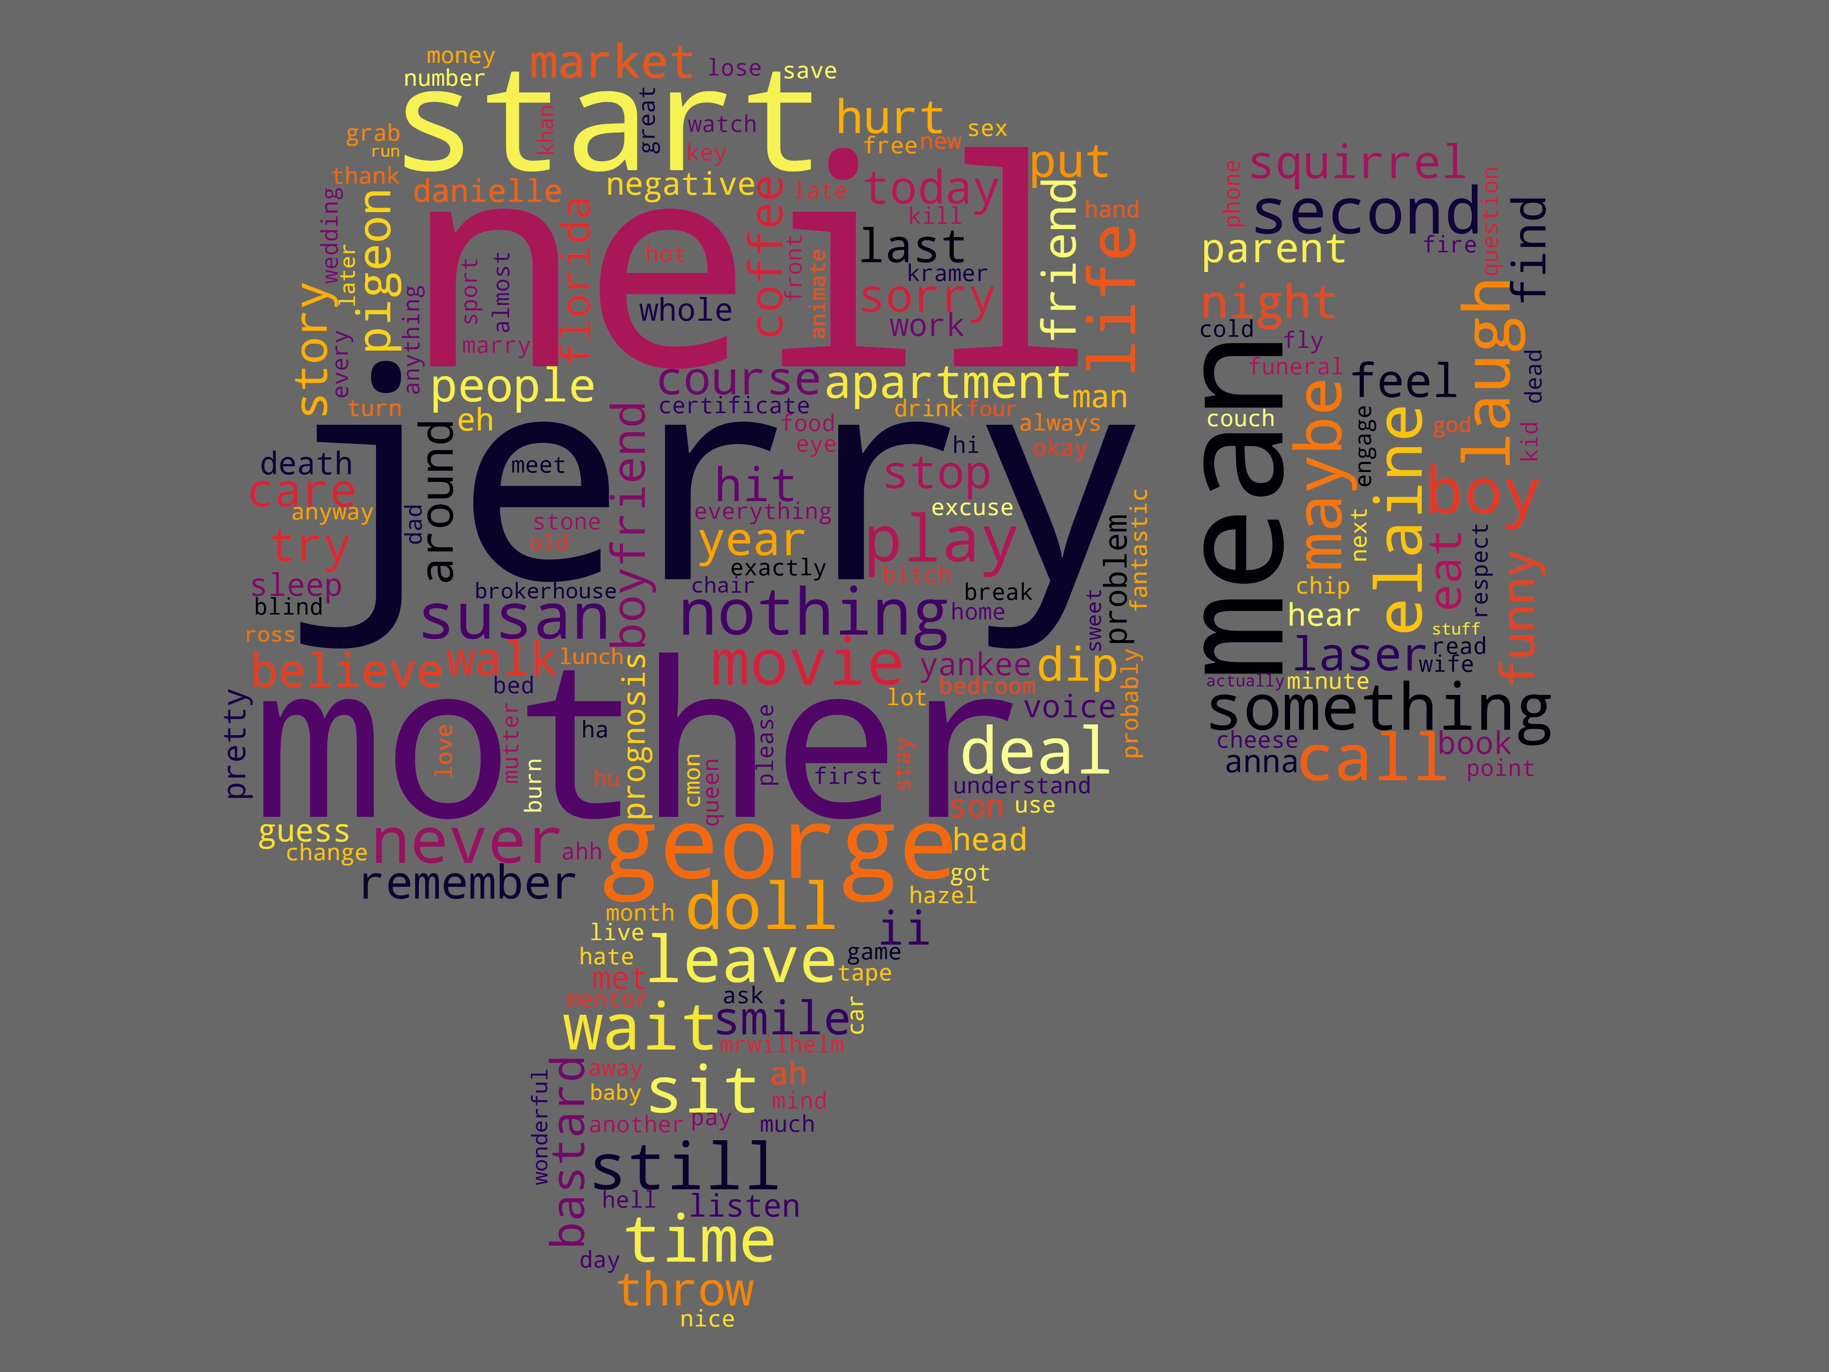
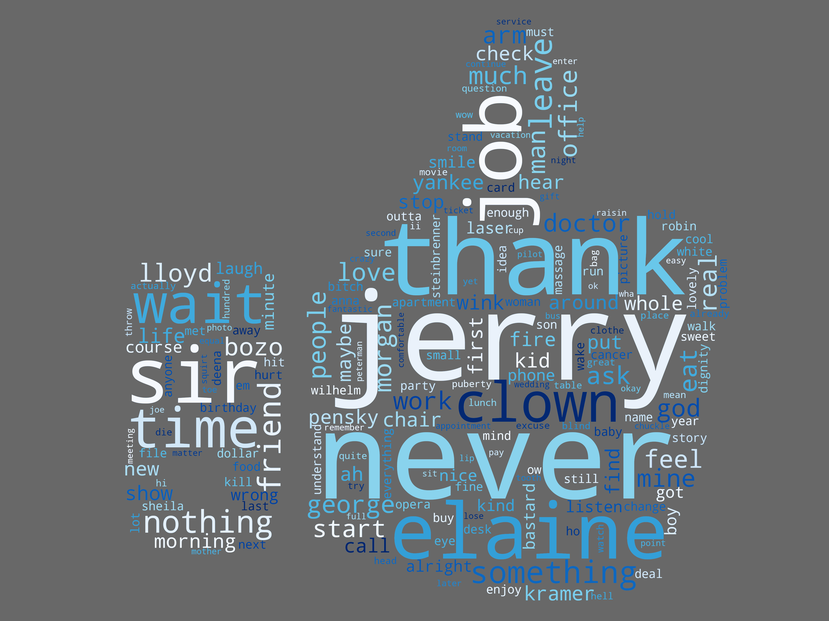
George Costanza is a Divided Man
Negative Sentiment
Positive Sentiment
Jerry, Mother, Susan, George (3rd person)
Jerry, Elaine, Job, Kramer, Thanks

Slide 24
George Costanza is a Divided Man
"You know if you take everything I’ve accomplished in my entire life and condense it down into one day…it looks decent!"

Slide 25
George Costanza is a Divided Man
"You know if you take everything I’ve accomplished in my entire life and condense it down into one day…it looks decent!"
“Just remember, it’s not a lie if you believe it”

Slide 26
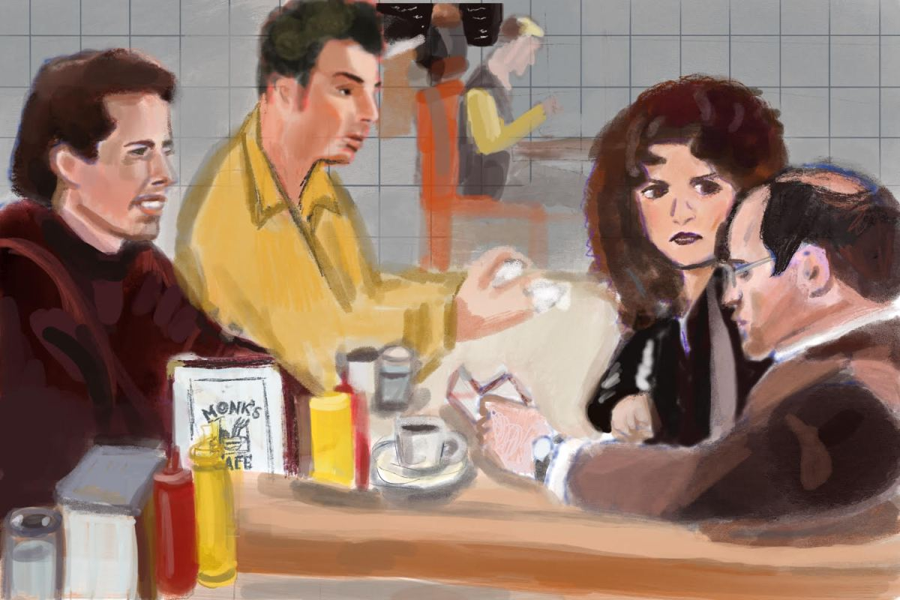
Future Improvements
More Topic Modeling – break into more topics
Explore emotions and sentiment within episodes themselves
Improve visualizations – overlay emotion graphs
Try other sentiment analysis methods

Slide 27
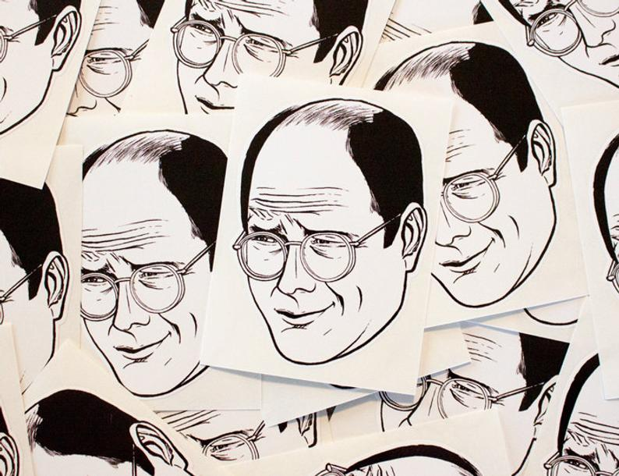
Thank You

Slide 28

References
Data:
Seinfeld Transcripts https://www.kaggle.com/thec03u5/seinfeld-chronicles
NRC Emotion Lexicon: http://web.stanford.edu/class/cs124/NRC-emotion-lexicon-wordlevel-alphabetized-v0.92.txt

Slide 29
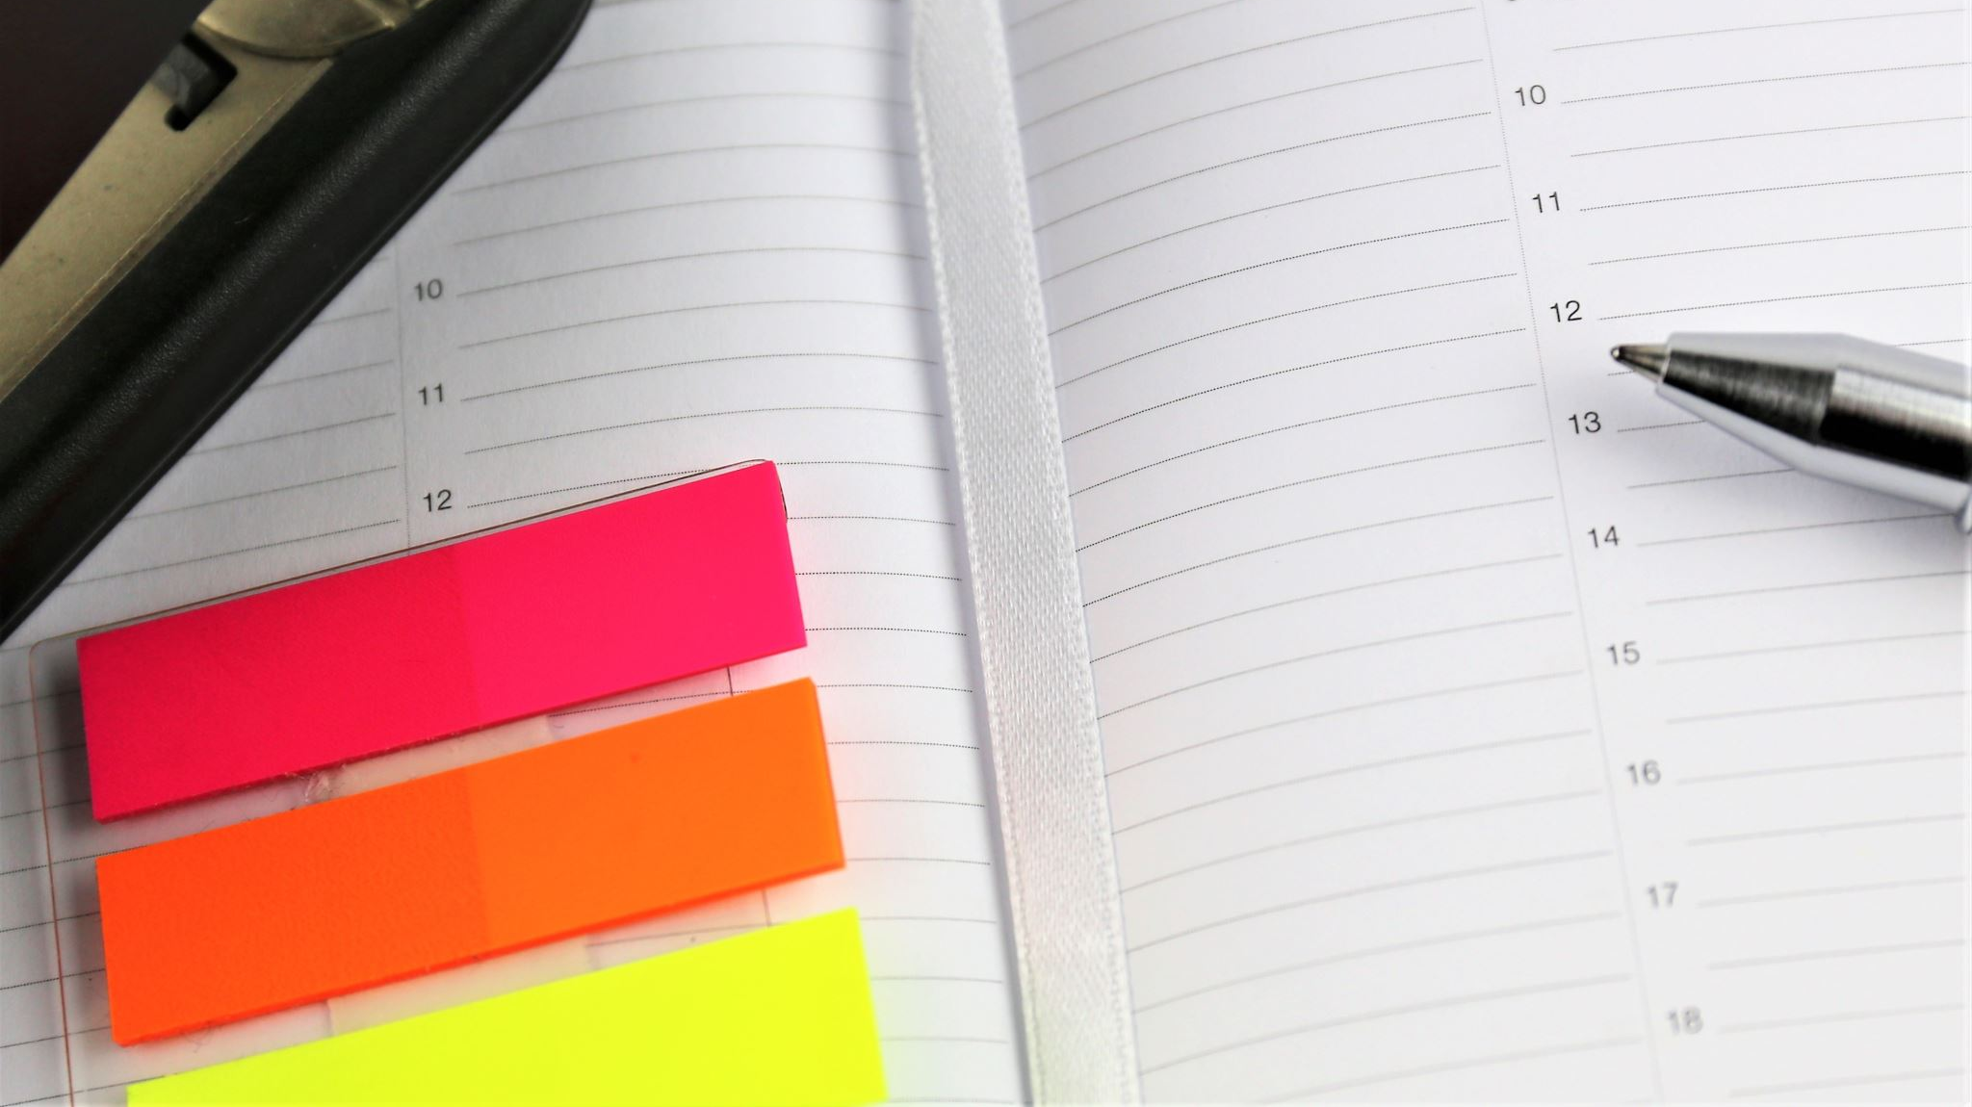
Appendix

Slide 30
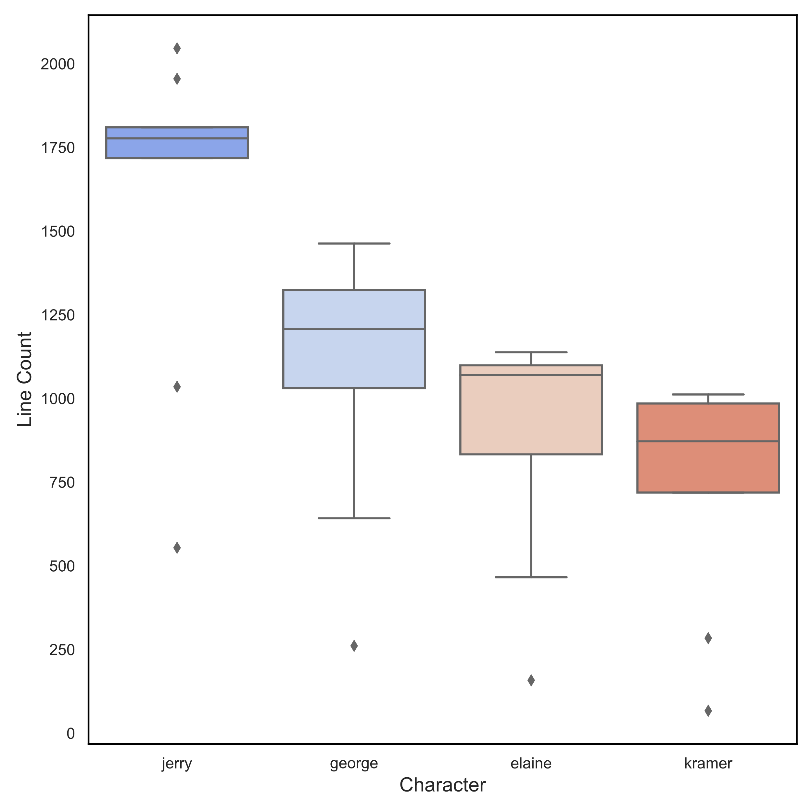
EDA
Character Line Counts Total

Slide 31
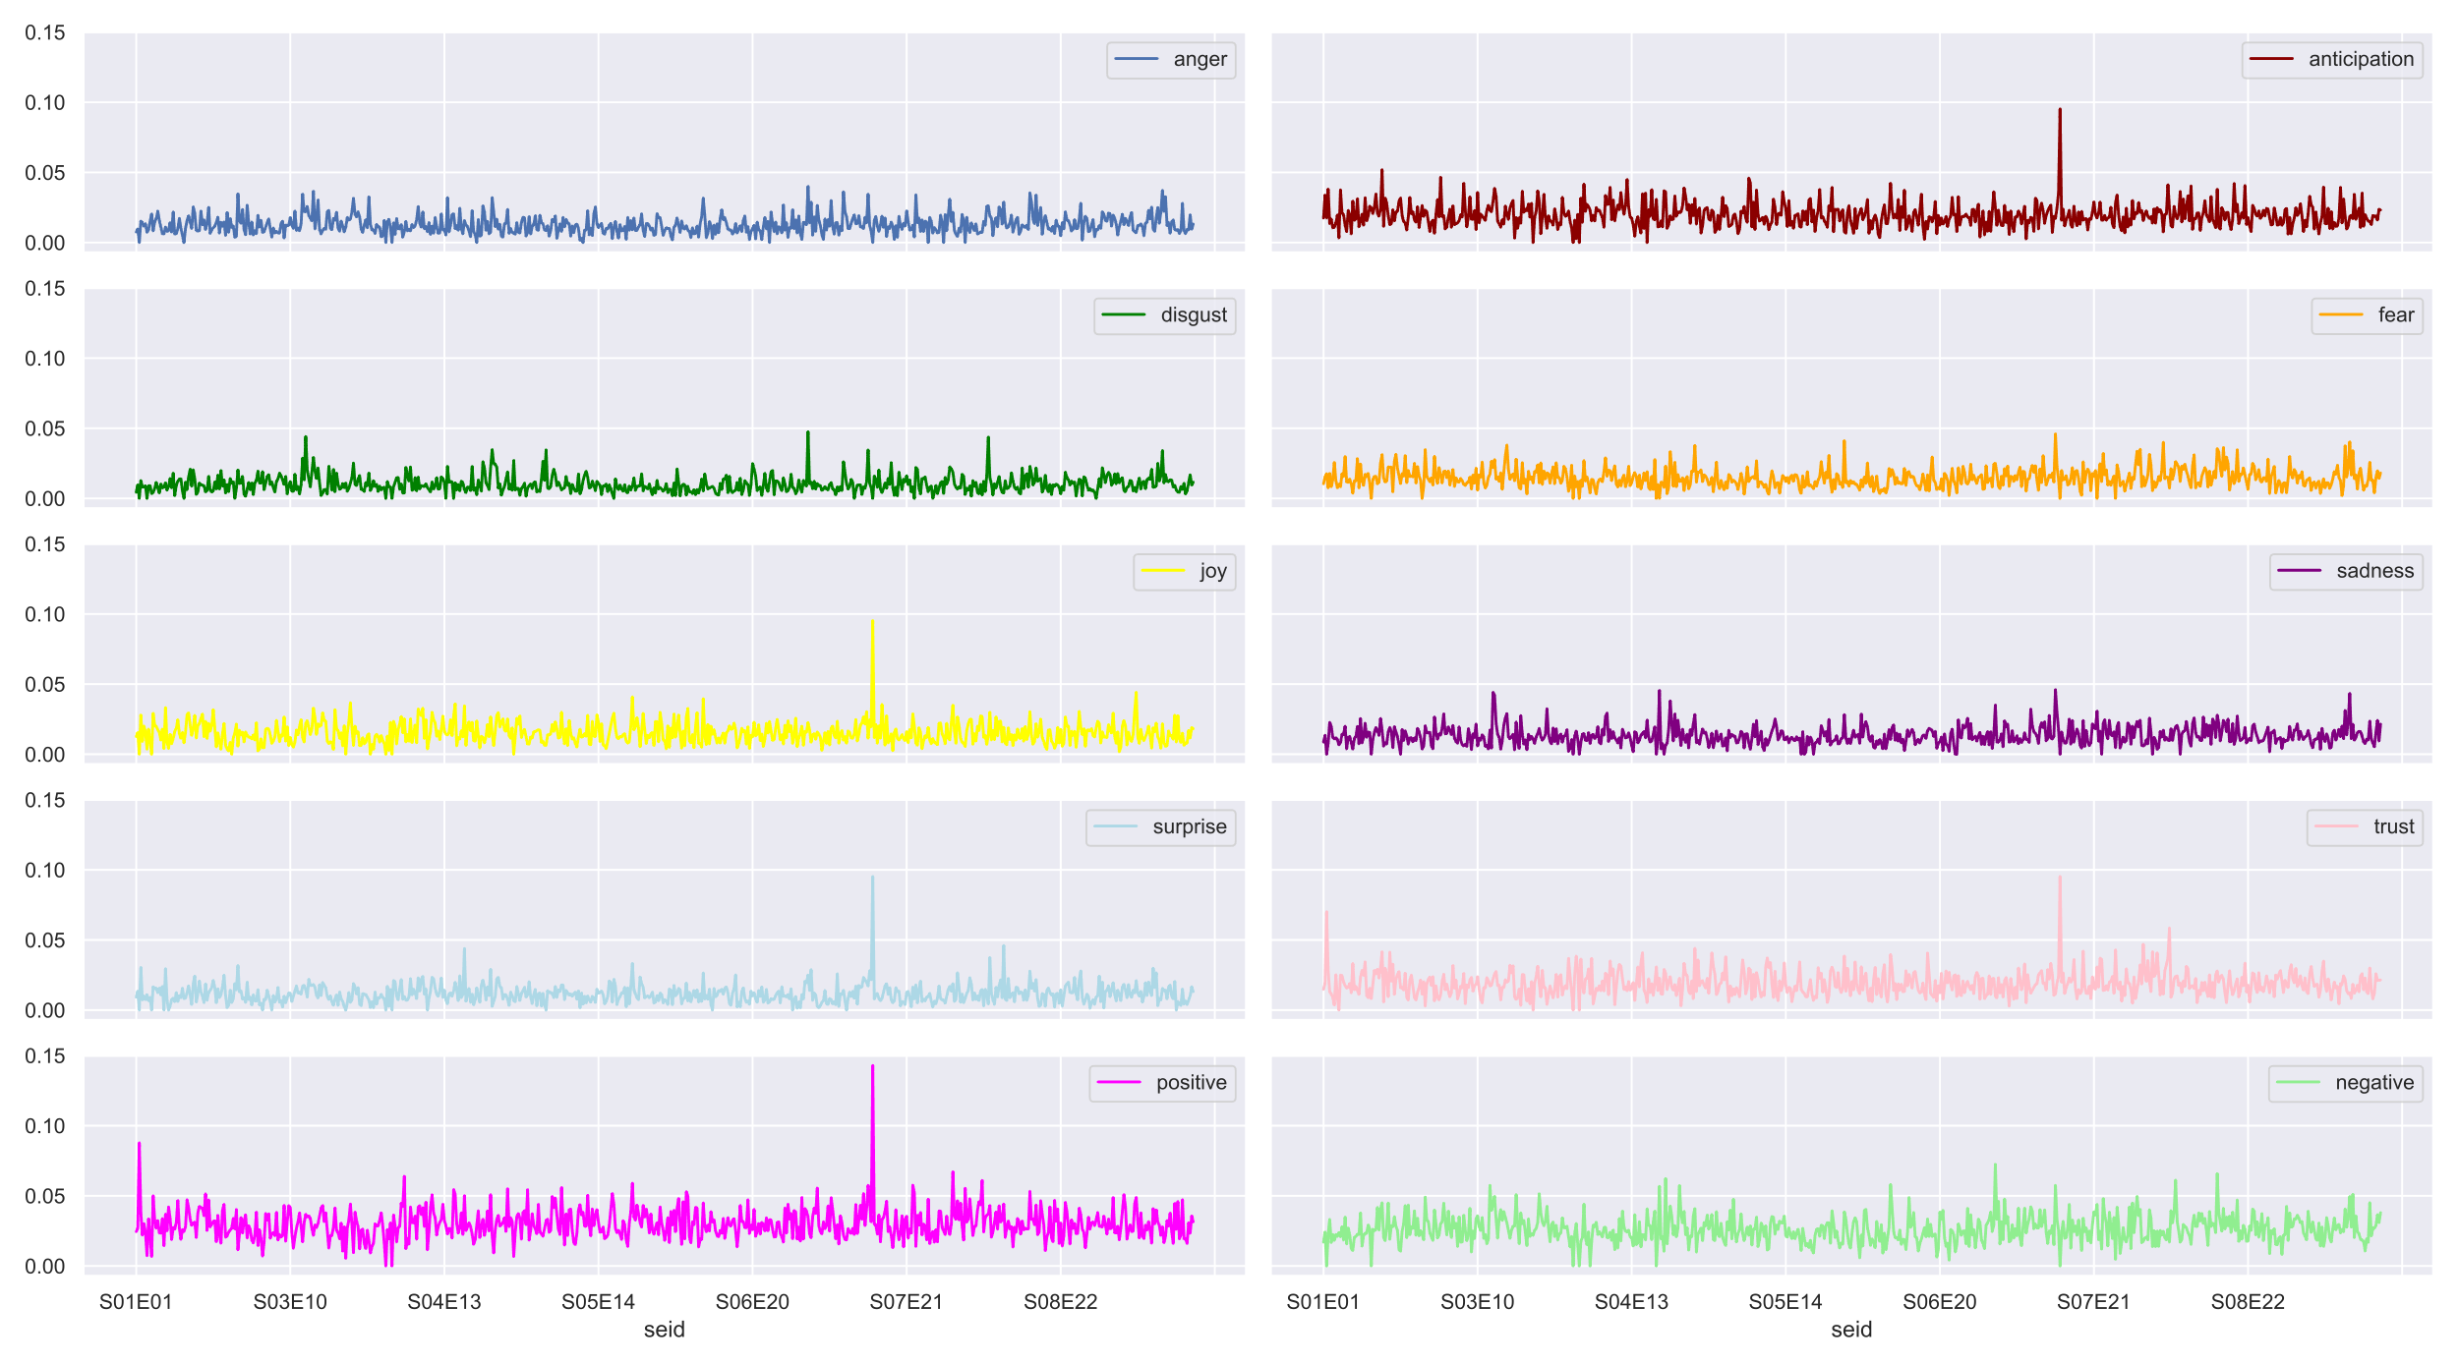
Emotional Analysis
All Characters

Slide 32
NMF Model Topic Words
Topic 0 george, coffee, woman, elaine, door, phone, night, bathroom, friend, work, world, office, today, machine, hell, wait, lot, problem, thank, date, toe, apartment, face, anyone, year, home, stuff, susan, god, head, sex, talk, story, nothing, please, dollar, hair, tape, movie, laugh, table, get, book, tell, place, kramer, girl, love, question, relationship, message, costanza, bald, nt, window, shop, kind, tomorrow, chair, jacket, person, walk, game, money, mind, eye, excuse, exit, ball, anybody, mother, voice, coat, chance, move, cup, food, break, sort, ticket, somebody, vandelay, pick, oclock, floor, see, smile, hang, side, listen, morning, watch, week, test, glass, arm, fact, doctor, cousin
Topic 1 car, bar, candy, space, dollar, lot, spot, front, park, door, window, head, coat, parking, kramer, father, store, please, phone, name, help, back, wait, hell, hat, hospital, city, heh, move, party, kid, machine, bill, job, deal, sorry, walk, mirror, nobody, talk, turn, start, chocolate, money, face, question, chair, mother, house, life, friend, notice, floor, business, excuse, cause, finger, dream, key, week, today, market, bit, somebody, fine, fall, get, kind, yankee, pay, work, gum, twenty, driver, listen, corner, drive, anybody, see, street, problem, noise, baby, society, buck, air, wallet, shout, woman, change, knock, stay, land, tell, nt, thank, foot, fire, chicken
Topic 2 nothing, show, idea, name, tv, life, story, plane, water, kind, woman, talk, kramer, god, store, paper, suit, money, son, tell, fine, place, table, job, thank, sport, meeting, lot, move, baby, piece, writer, business, toilet, care, year, person, food, sir, eye, movie, card, apartment, doctor, order, jacket, hell, fire, deal, pilot, favor, week, dollar, friend, excuse, nobody, war, get, wait, laugh, elaine, team, morning, beat, tomorrow, school, phone, arm, soda, glass, nt, secretary, desk, number, please, forget, somebody, today, head, smile, happen, mirror, remember, end, meal, fruit, mine, bag, work, voice, fact, bit, book, restaurant, sort, dad, yankee, shirt, drink
Topic 3 hand, parent, life, salad, woman, kramer, friend, money, mother, face, job, kind, lunch, thank, work, head, dollar, shirt, apartment, dinner, talk, table, get, chuckle, god, father, check, office, year, conversation, arm, ticket, lot, clothe, place, sit, pass, service, card, sex, house, dad, finger, deal, mind, nod, difference, shell, photo, test, picture, restaurant, night, gesture, problem, tonight, fun, street, please, phone, play, plan, moment, kid, yankee, truth, air, voice, move, door, eat, building, week, respect, wait, scream, tomorrow, bathroom, park, hold, nt, board, baby, power, today, trip, step, elaine, waitress, mouth, eye, morning, game, heh, pause, toast, york, smile, piece

Slide 33
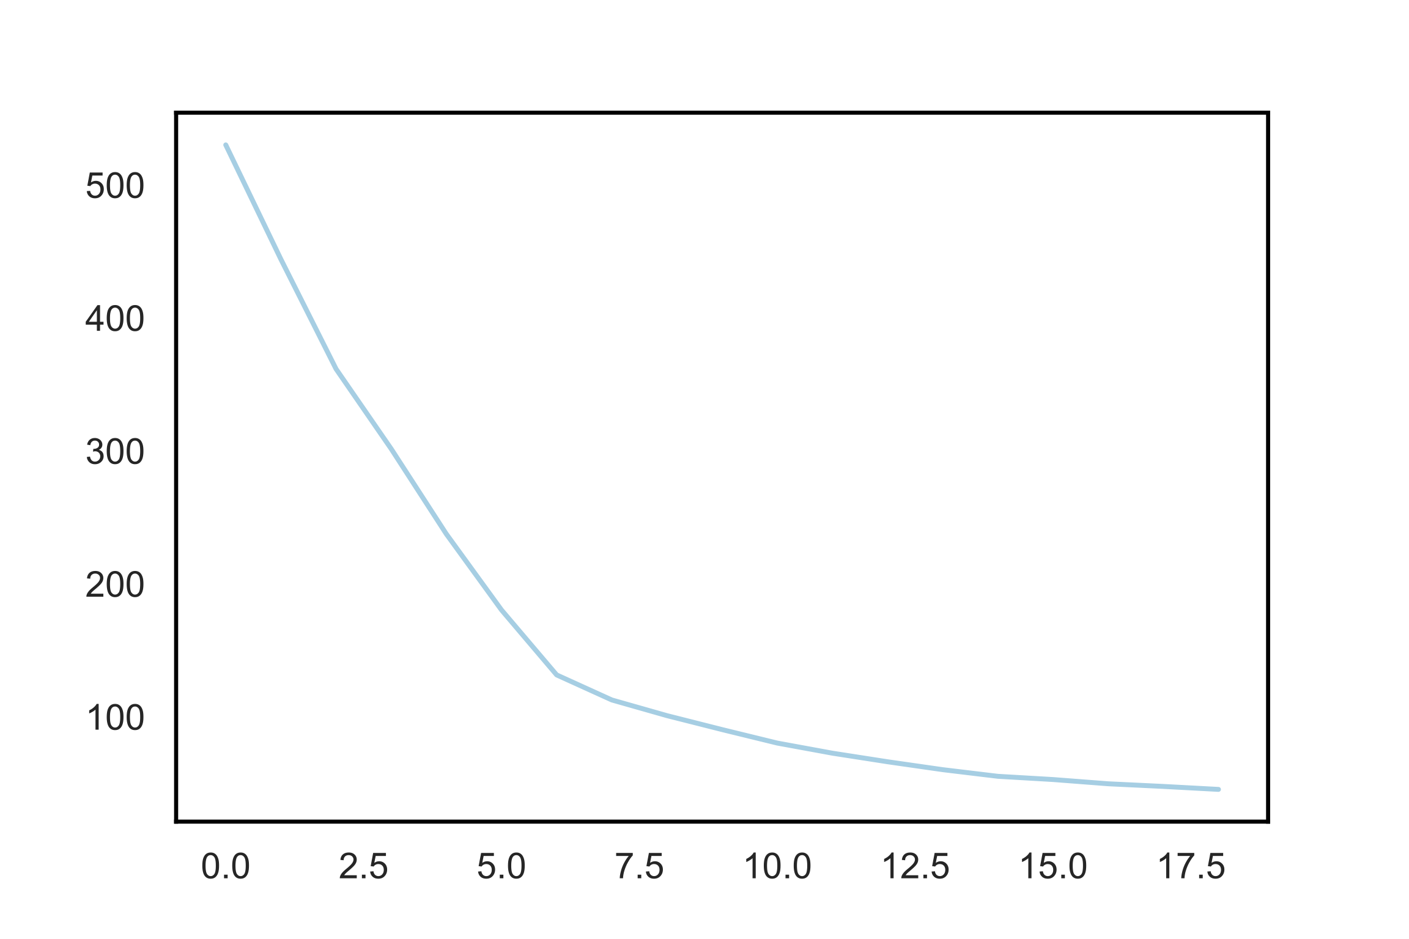
Kmeans Clustering Inertia
NMF model
Topics=4
Min_df=0.03
Max_df=0.85

Slide 34
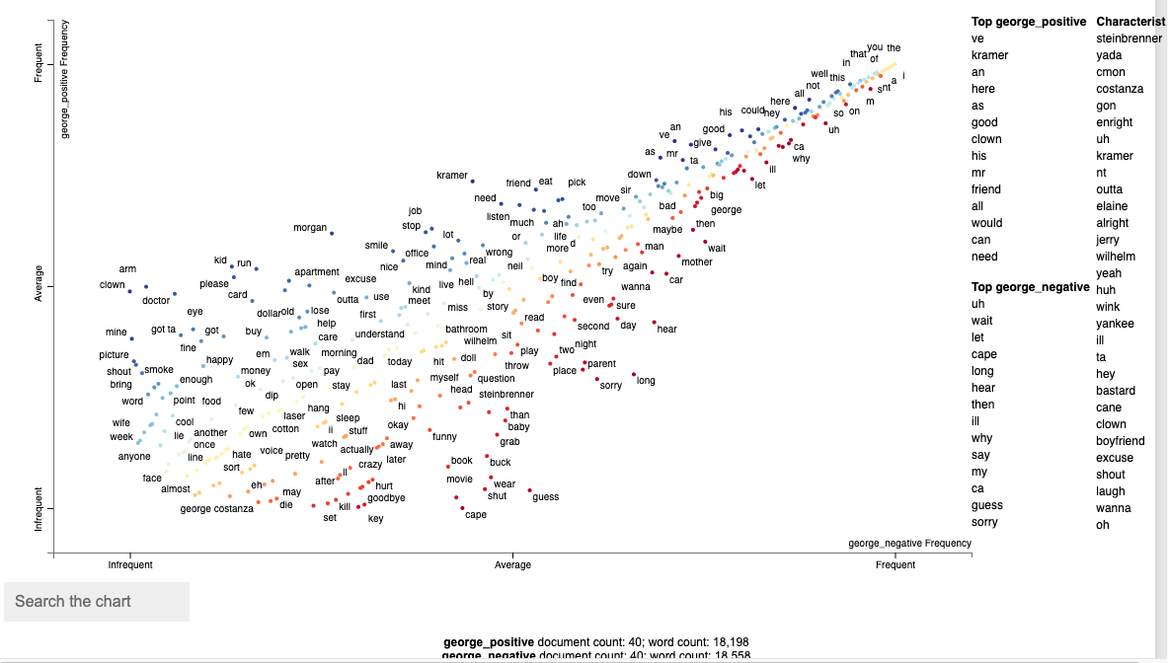
Scatterword – Costanza Positive/Negative

Slide 35
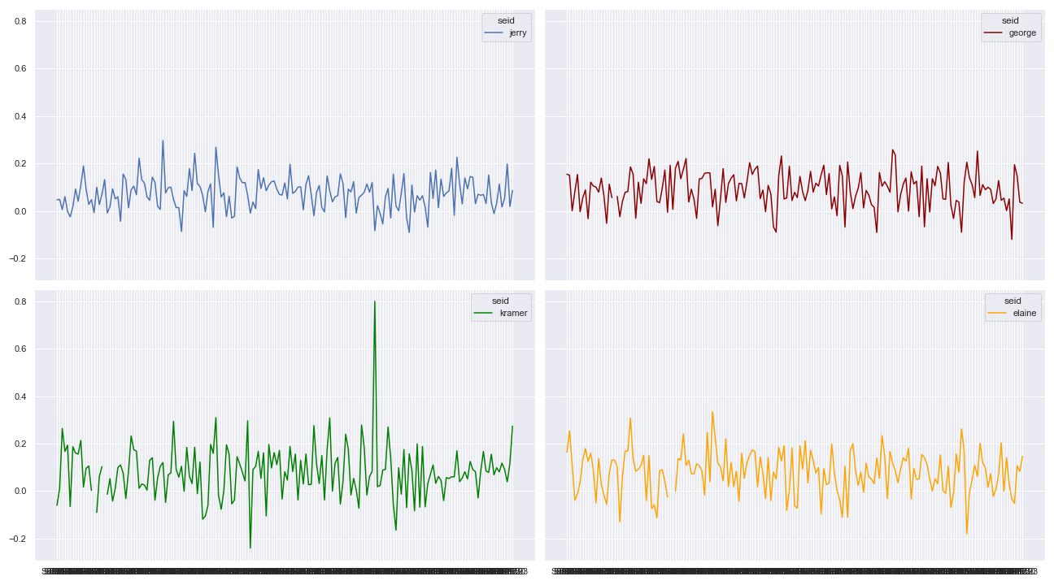
TextBlob – Sentiment Analysis, All Characters

